Slide 1

Day 1: Princeton, IL RSC Tour & Seminar
Tuesday, February 18th, 2020

Slide 2
Welcome to
Princeton Ace RSC!
Joe Weber – Princeton RSC Manager
Nick Oertel - Warehouse Manager

Slide 3
Agenda
Time | Topic
10:00 am | Welcome to Princeton
10:30 am | Barcodes
11:00 am | Weights & Measures
11:30 am | Quick Response
12:00 pm | LUNCH
12:30 pm | RSC Tour
2:00 pm | Traffic
2:30 pm | BREAK
2:40 pm | Inventory/Demand
3:10 pm | Supply Chain
4:00 pm | Return to Oak Brook

Slide 4
Barcodes
Chester Fritz, Senior Bar Code Analyst

Slide 5
Agenda & Objectives
Agenda
Bar Code Requirements
Bar Code Chargeback Policy
How to Avoid Penalties - Examples
Objectives
Familiarize vendors with Ace Requirements
  Adoption of the GS1 global bar code system standards
Help new vendors understand how used and how to check bar codes
Where to turn for questions or assistance

Slide 6

My Role & Responsibilities
Bar Codes - All Facets > Symbology, Applications, Equipment
  Bar Code Standards Compliance > Global Suggested Guidelines
  Management & Maintenance of all internal Bar Code Data
  Training – Suppliers, RSCs, Retailers
      Certified GS1US Standards & Fundamentals
Ace Hardware Corporate Staff
  Assist & Advise all Business Partners regarding Bar Codes
    Focused on Distribution Centers Operations and Retail
    Equipment Expertise
Bar Code Charge Back Policy
  Administer Charge Back Policy & Program - insure compliance

Slide 7
Bar Code Requirements
Ace Hardware supports GS1 globally adopted system standards
New Term
  GTIN > GLOBAL TRADE ITEM NUMBER = DATA
    Data encoded in a Bar Code Symbology
    GTIN-12 (POS)
    GTIN-14 (Distribution)
New Rules
  CHANGE effective Jan 1, 2019, GTINs will not be reissued/reused.
  Exception - Not entered the Marketplace, Not Communicated to Business Partners
Notes:
Based on scanning purpose and Industry - Retail or Distribution,
GS1 specifications manual for detailed technical attributes
*The original ANSI “Barcode Print Quality Guideline” was published in 1990 and established procedures and standard measurement methodology for measuring barcode quality, Initially established eight attributes of print quality measured. It has been revised several times since, and now consists of 9 measured parameters.

Slide 8
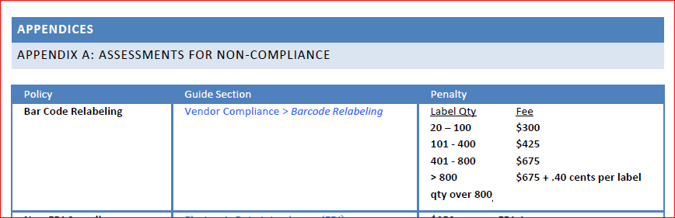
Vendor Manual
Page 24
Barcode Chargeback Policy
Per Reporting RSC

Slide 9
What will get you in trouble:
Unscannable Bar Codes
  General Rule – Not Infringed by packaging, artwork, product, other labels, etc.
  Properly Formatted Symbols –Correct for Pkg level
    Guard Pattern, Recommended Sizes, Bearer Bars
  Wrong Symbology Usage
  Wrong Encoded Data (GTINs)
  Proper Placement
    Round surfaces, Heavy Product, Hidden Hang Tags Clam Shell or product Infringement

Slide 10


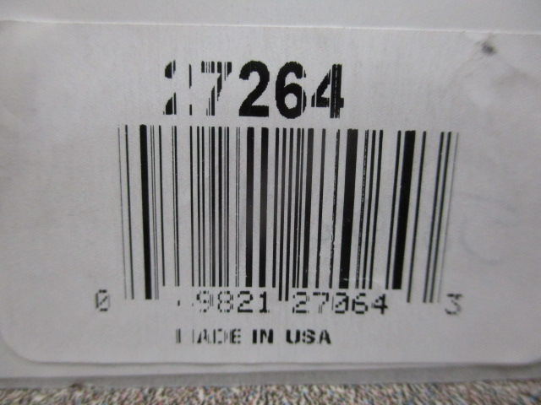
Retail Unscannable Examples
Poor Printed Quality
[Preventable]

Slide 11

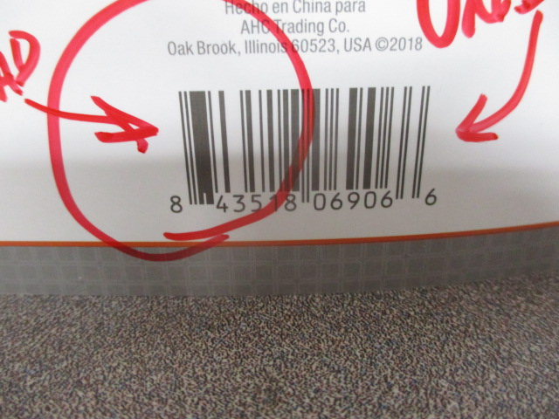
Retail Unscannable Examples
Poor Printed Quality
[Preventable]

Slide 12
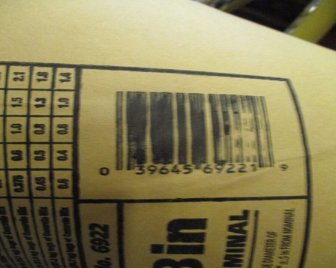

Retail Unscannable Examples
Poor Printed Quality
[Preventable]

Slide 13

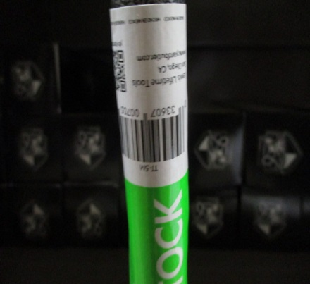
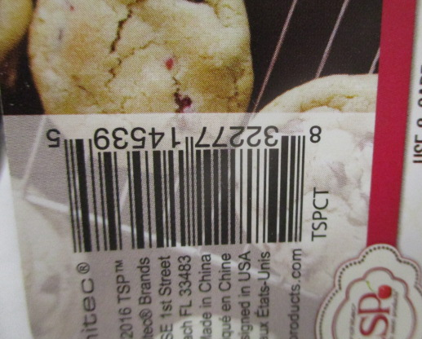
Retail Unscannable Examples
Design and Development – Review Final Production
This Photo by Unknown Author is licensed under CC BY

Slide 14

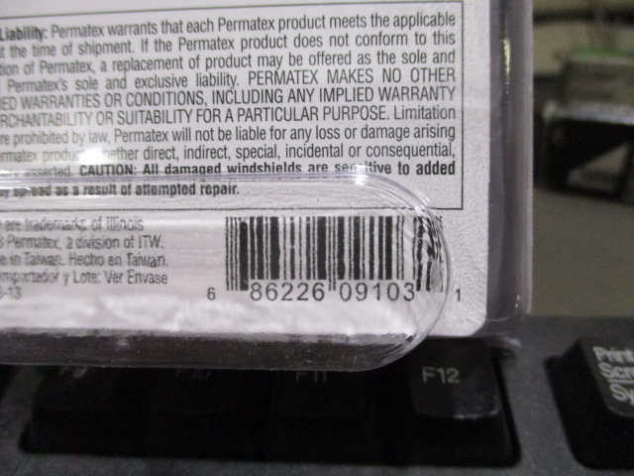
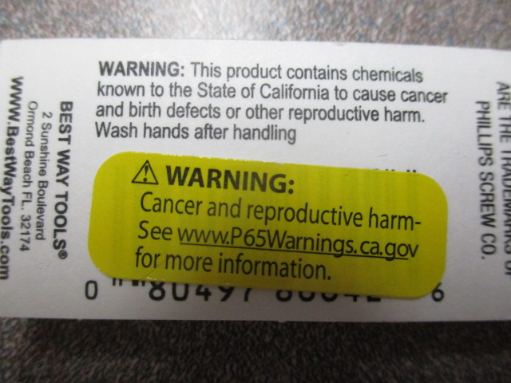
Retail Unscannable Examples
Infringements – Packaging & Stickers

Slide 15

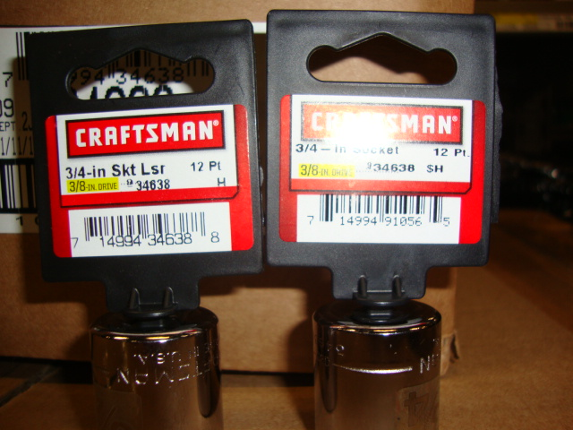
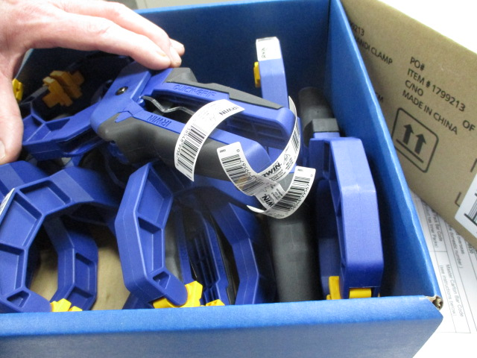
Retail Unscannable Examples
Packaging & Stickers

Slide 16
Non-Retail Unscannable Examples
Non-Retail Shipping Cartons
  Lower Right Corner, Two Adjacent sides
  Min 1/8” from horizontal and vertical edge
  Do Not Cover by Strapping, Banding, Tape, Etc.
  Not Wrapped around edges
  Be sure any Express Shipment Labels do not cover

Slide 17
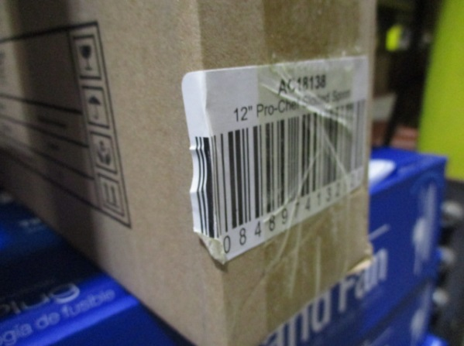
Non-Retail Unscannable Examples
Unscannable Cause?
Wrapped around edges

Slide 18
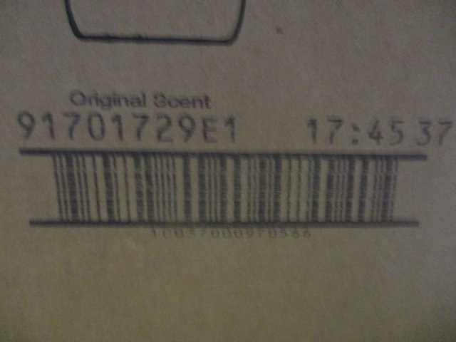

Ink Jet Direct Imprinted is Inefficient & Not Acceptable
Non-Retail Unscannable Examples

Slide 19

Test Your Bar Code
Printed Quality Control
  Print Quality is Measured to ANSI/ISO standards*
  Bar Code symbols are verified in accordance with
  ANSI X3.182-1990 and ISO 15416
  VERIFIER IS A
  Calibrated Measuring Devices
  –Not a Scanner/Reader
  Ace does tests and verifies bar codes meet Standards and Expectations!

Slide 20




Call to Action
Review you bar codes for compliance to global adopted requirements.
Test your bar codes using the proper equipment.
Check your bar codes in finished packaging to avoid the unknown.
Consider attendance at the GS1 Connect Conference for more education.
Clean up your data.
Welcome to GS1 US
The Global Language of Business

Slide 21


Chester Fritz
Senior Bar Code Analyst
Supply Chain
Want to Know More?
815-876-2592
  cfritz@acehardware.com
  barcodes@acehardware.com

Slide 22


Questions?
What is the #1 Cause for Delays in the Checkout Line?
POOR PRINTING

Slide 23
Weights & Measures: Package Measurement Guidelines
Ted Akers, Product Data Specialist, Supply Chain

Slide 24
Agenda & Objectives
Agenda
New Item Start Audits
Packaging
New Item Audit Charges
Objectives
Determine the correct way to measure Retail items
Understand packaging rules for non-retail items
Help vendors to avoid penalties

Slide 25
New Item Start Audits
When New Items are received in the Princeton RSC, an audit is done to verify data submitted by the vendor to actual product received:
  Dimensions ( All Levels of Packaging)
  (make sure dimensions are in the correct order for the retail item)
  Weight (All levels of packaging)
  Bar Codes (All levels of packaging)
  If Discrepancies are found they are corrected at that time to our master Data Files
  Ace Allows a 4% variance on weight and dimensions

Slide 26
Package Measurement Rules:
Retail Items
Determining the Default Front :
Prior to any measurement capture, the Default Front must be determined.
Surface with the largest area that is used by the manufacturer to “sell‟ the product to the consumer
Includes markings such as the product name and standard text elements such as Consumer Declaration (e.g., Net Content).

Slide 27
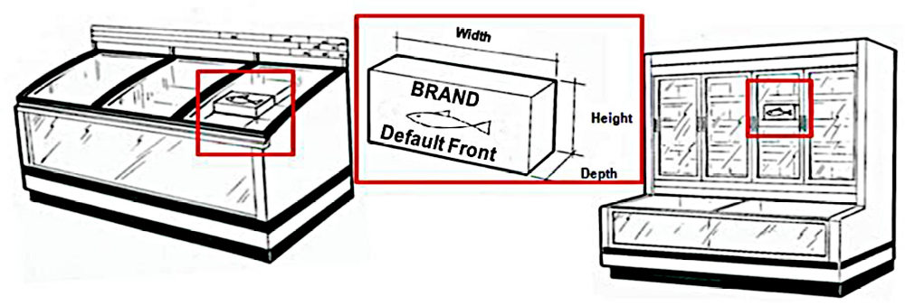
Package Measurement Rules
Important: The determination of Default Front is intended to provide a consistent, repeatable process to determine measurements for a given product package and may not always represent the “as merchandised” or shelf orientation of the product as illustrated below:
Default front is determined independent of shelf orientation

Slide 28
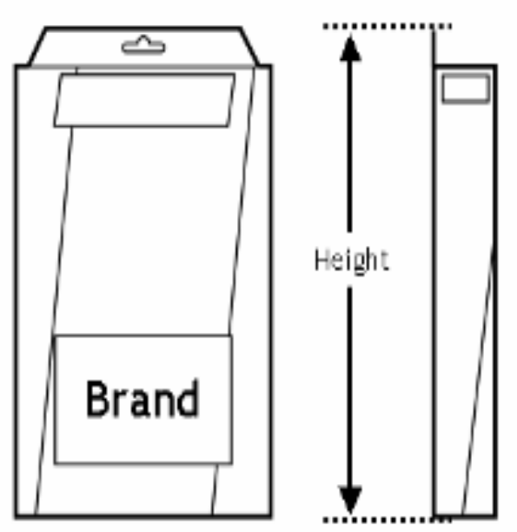
Package Measurement Rules
Hanging-item
A Hanging-Item is a trade item that is presented on a hanger or contains a hole for hanging purposes.
Always measure hanging items as if hanging

Slide 29
Package Measurement Rules:
Non- Retail
Determining the natural base:
The Natural Base of the non-consumer trade item must be identified before the height, width and depth can be determined. The Natural Base is the natural underside of the packaged item (e.g. case).
For consistency in measuring:
Determine if case markings point to natural base orientation. If text, arrows or other graphics printed on the item may indicate a top or bottom orientation, they take precedence in determining the Natural Base.

Slide 30

Package Measurement Rules
Important: If the position of a logo or product mark does not indicate top or bottom orientation, it is not used to determine Natural Base.

Slide 31
Package Measurement Rules
After determining the Natural Base, the height, width and depth of the non-consumer trade item can be determined:
Height: the distance between the Natural Base of the non-consumer trade item and the top.
Width: the shorter side of the natural base of the non-consumer trade item.
Depth/Length: the longer side of the natural base of the non-consumer trade item.
Make sure you capture any protrusions that may extend above, such as handles.

Slide 32
New Item Audit Charges
These charges are per item audited:
Dimension Discrepancies = $50
Weight Discrepancies = $50
Bar Code Discrepancies = $50

Slide 33
Call to Action
Review your product submissions and submit corrections to your Ace Merchant.
If you have received a New Item Start charge, you should review what caused the charge.
Review recently submitted items to see if they may have the same issues. If they do, submit corrections to your Ace Merchant.

Slide 34
Want to Know More?
The most common errors we see are with retail items where the dimensions are in the incorrect order. Ace is VERY dependent on your dimensions being correct when setting up planograms for our retailers
Resource: GS1 US Packaging Measurement Guidelines, the guidelines that Ace Hardware follows and are available within the Ace Vendor Manual.
Contact: Ted Akers takers@acehardware.com
E-mail – WMDomestics@acehardware.com
Phone – 815-876-2593

Slide 35

Questions?

Slide 36
Quick Response: Inbound Load Quality
Laurie Nauman, Senior Supply Chain Coordinator

Slide 37
Agenda & Objectives
Agenda
Quick Response Program & Requirements
Shipping through Ace Hardware Cross Docks
Small Package Requirements
Objectives
Provide understanding of Quick Response Inbound Shipping Requirements​
Importance throughout the Supply Chain to ship in compliance to Ace’s Inbound ship guidelines

Slide 38

Ace Quick Response Program
Inbound Shipping Requirements for all RSC-stocked vendors to follow
Load Quality
Quicker Check-In and Posting of your products to inventory
Compliance increases efficiencies throughout the entire Supply Chain for:
Our Vendors
Ace Retail Support Centers
Carriers
Ace Retailers

Slide 39
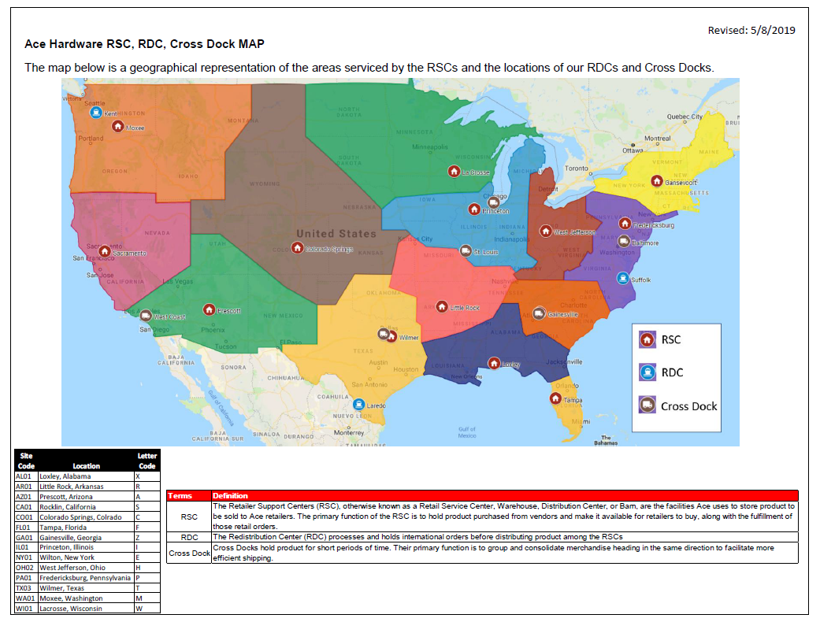

Slide 40
Quick Response Load Quality Shipping Requirements
Utilize a Good Quality, Solid Hardwood Pallet
Merchandise Shrink Wrapped & Pallet Labeled “Do Not Break Shrink Wrap”
Pallet Contents Identified
Attach 1 Copy of Packing List to Freight & Transmit 856 ASN via EDI
Shipment Sorted & Segregated
Mixed Item Pallets Stacked to 60” or Less & Single SKU Pallet 42” or Less
Bill of Lading Terminology
Merchandise Delivered on Preferred Carrier

Slide 41
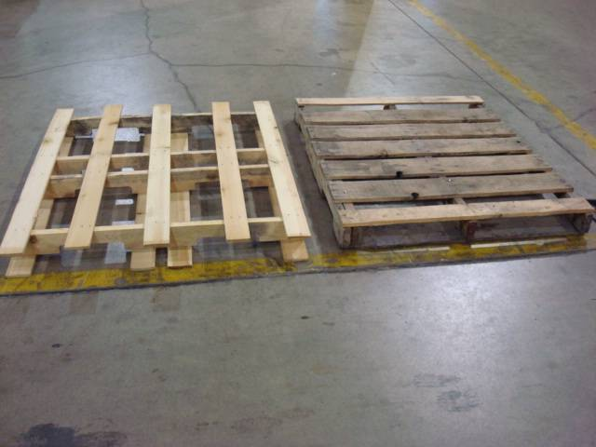
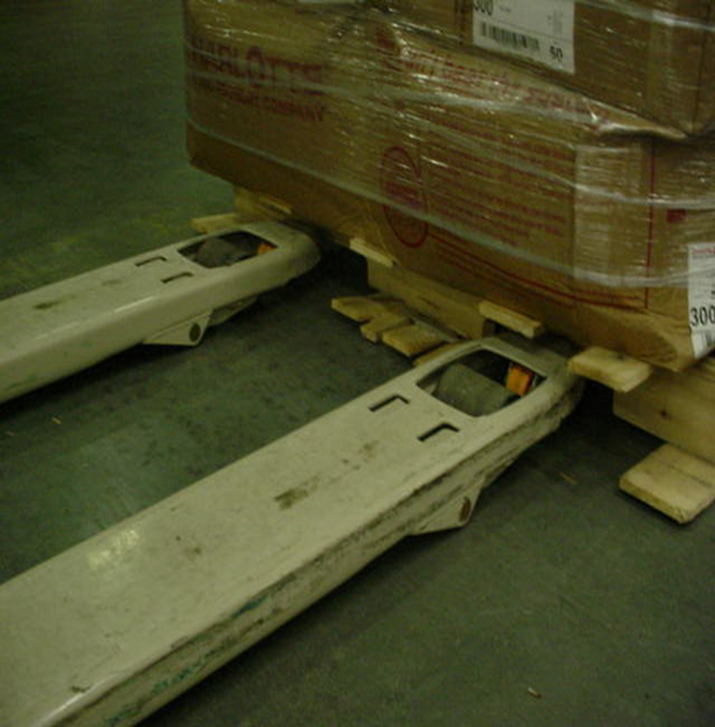
Ship on a Good Quality Hardwood Pallet
40” X 48” 4-way preferred

Slide 42
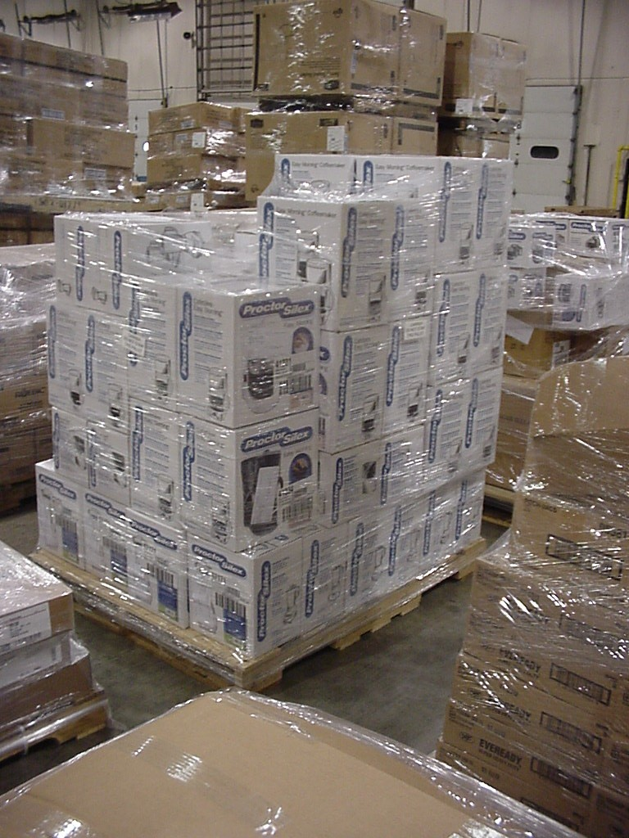
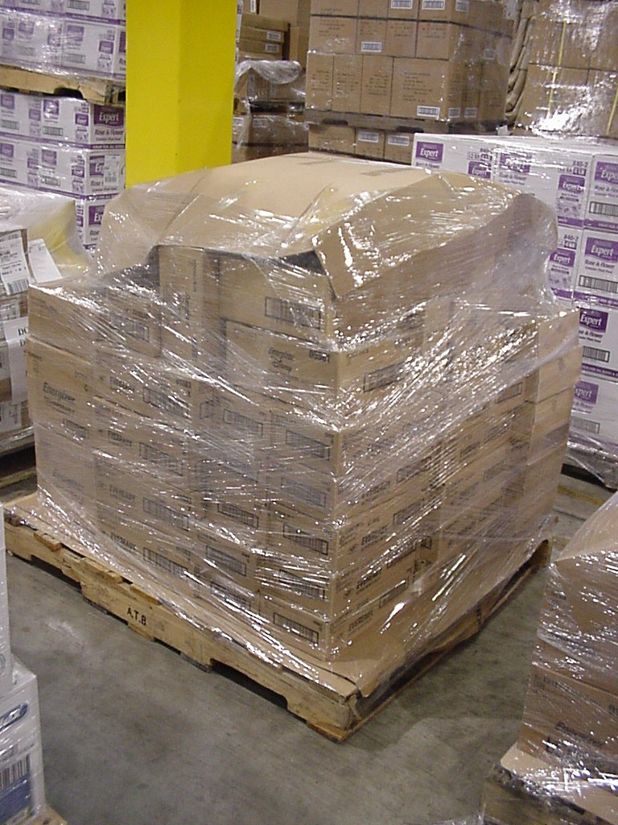
Shrink Wrap to Include Pallet
Uncapped
Capped

Slide 43
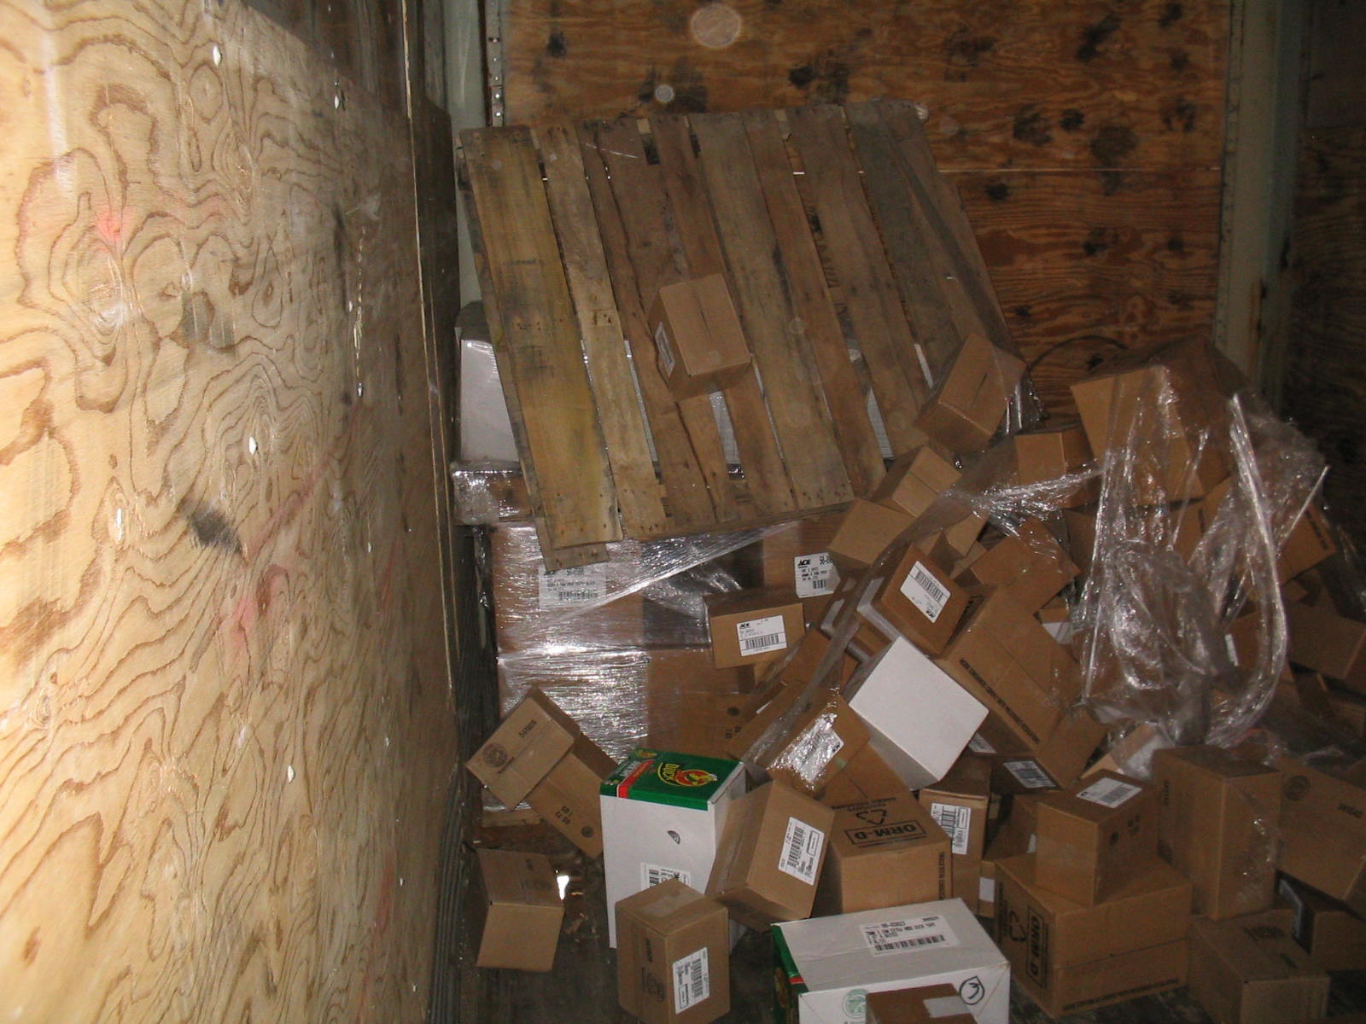
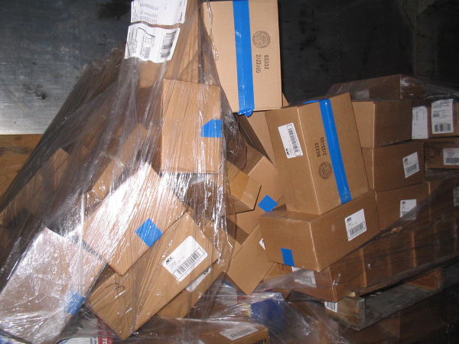
Poorly Wrapped Pallets

Slide 44
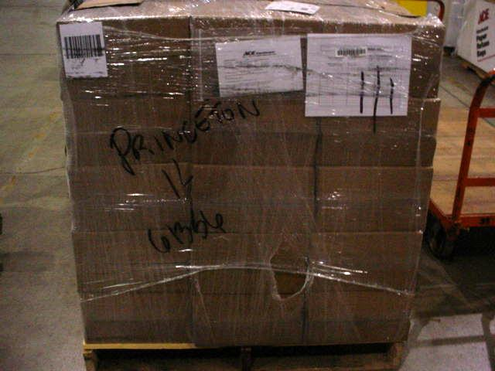
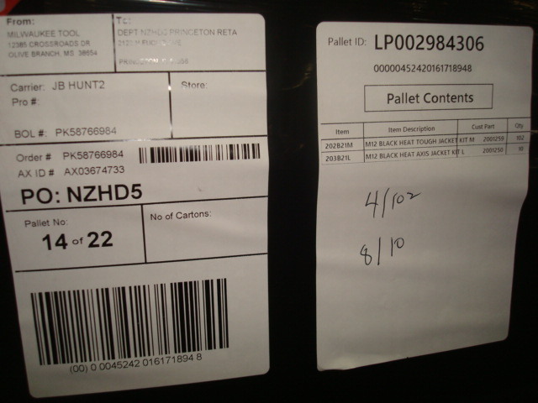
Pallet Contents Identified
Attach a pallet placard to each individual pallet, listing Mfg # and Quantity of each item on the pallet.

Slide 45
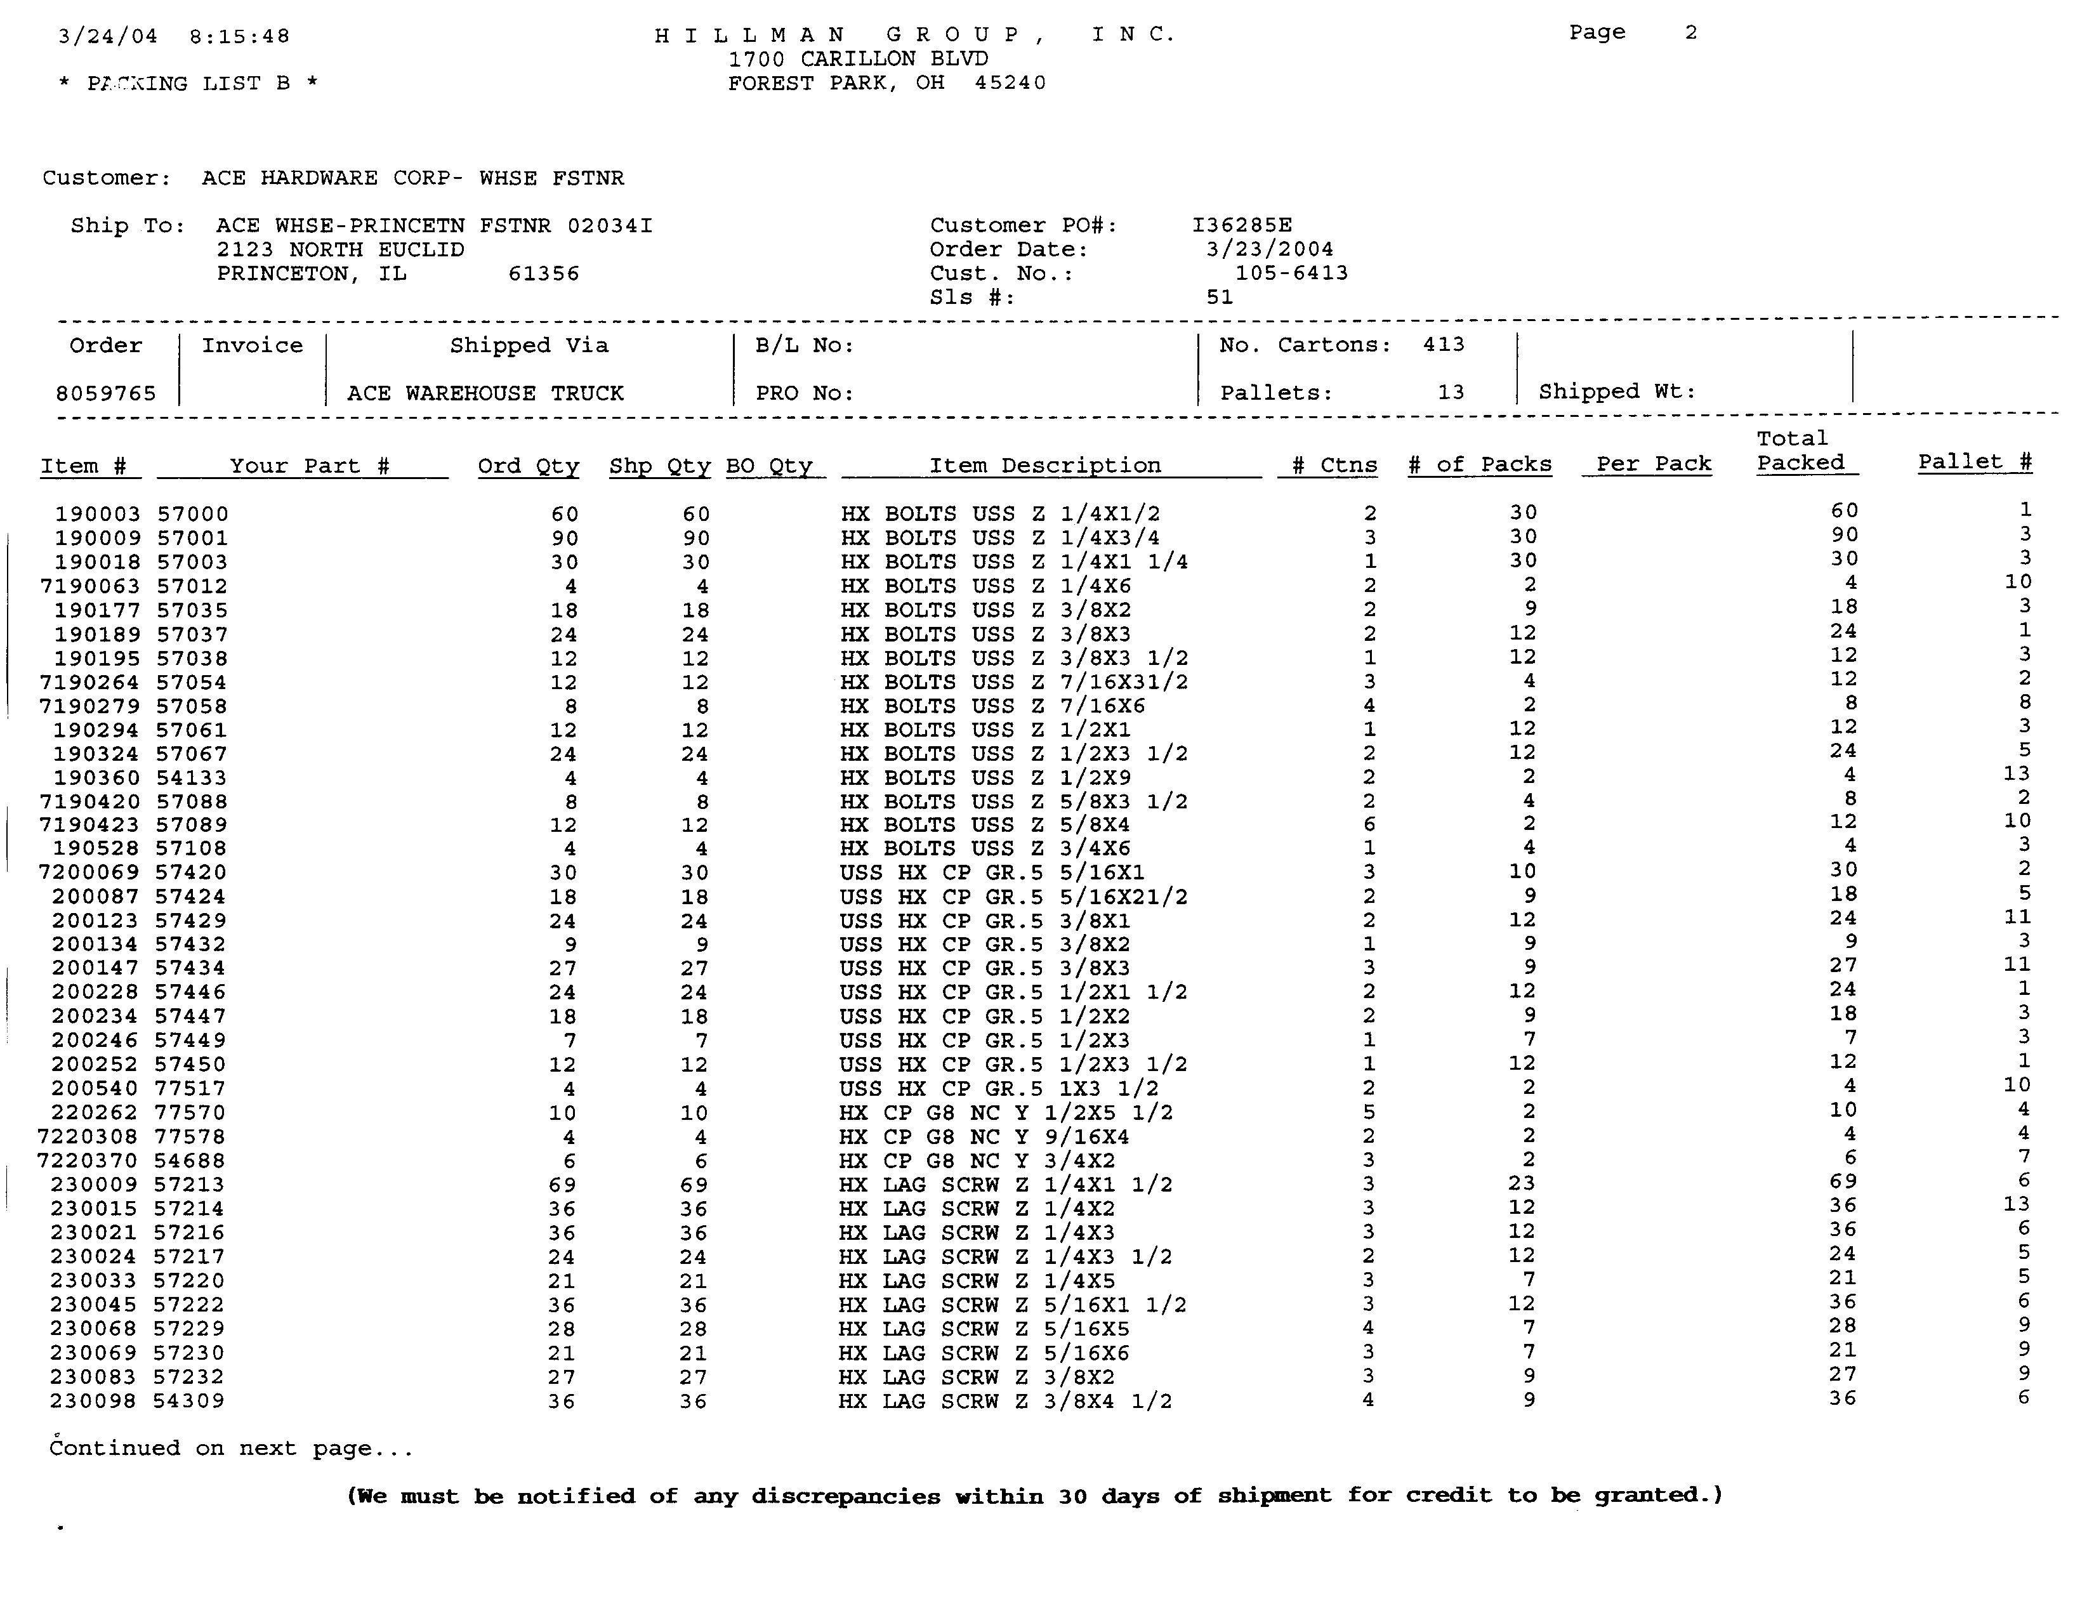
OR Number the pallets AND
List the Pallet ID # on the packing list

Slide 46
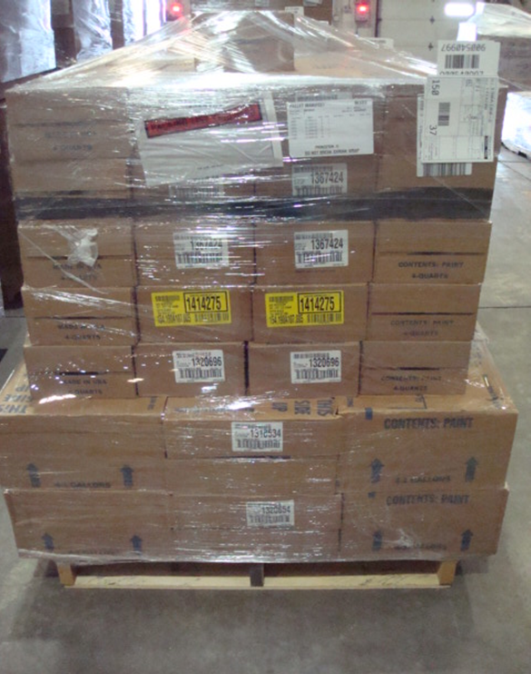
Attach a Packing List in a Clear Plastic Pouch
Transmit 856 Advance Ship Notice (ASN) via EDI

Slide 47

BUILD SINGLE SKU PALLETS when Ace Purchase Order Quantity meets or exceeds a full pallet quantity.
DO NOT MIX POs onto the SAME PALLET !
Shipments Sorted & Segregated

Slide 48
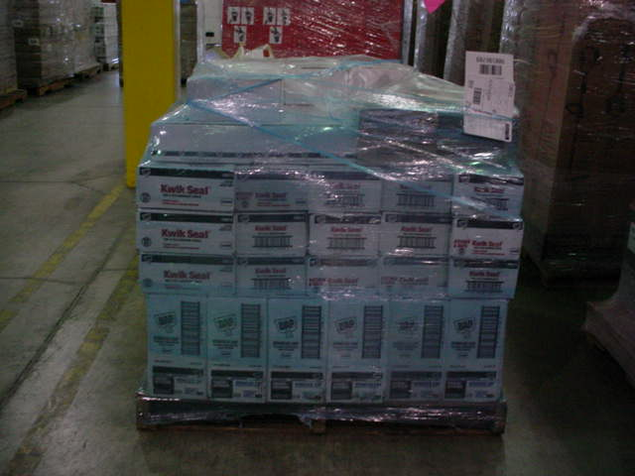
Shipments Sorted & Segregated
Keep same SKUs together on the same pallet
Keep the same SKU together in layered quantities
DO NOT SPREAD SAME ITEM ACROSS MULTIPLE PALLETS !

Slide 49


Pallet Heights
Single SKU pallet = 42”
Mixed SKU pallet not to exceed 60”

Slide 50
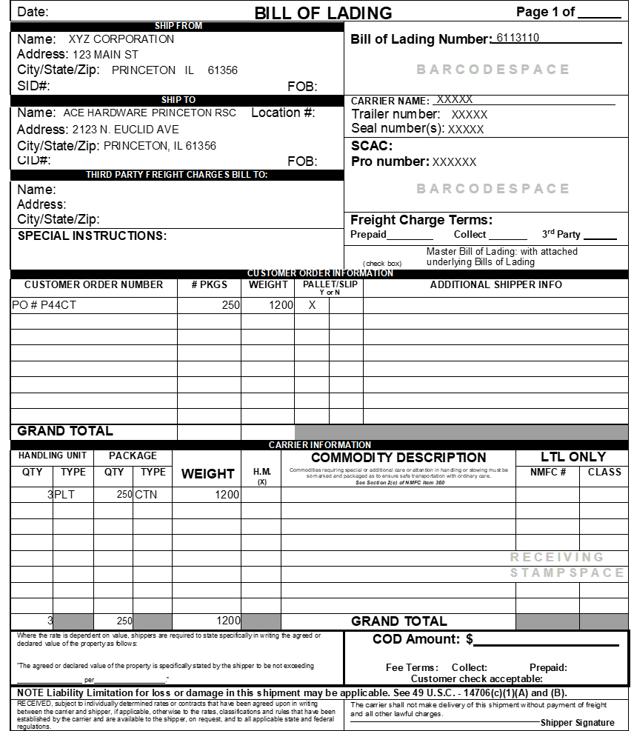
Bill of Lading
Bill of Lading Terminology
XX Pallets stc
XXX cartons

Slide 51
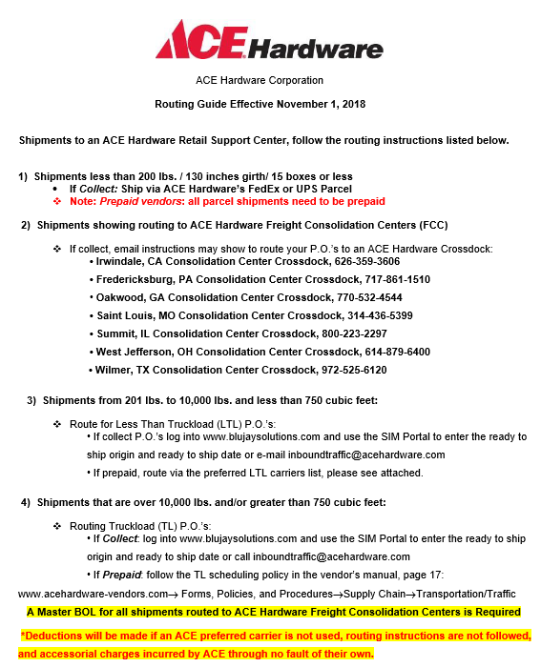
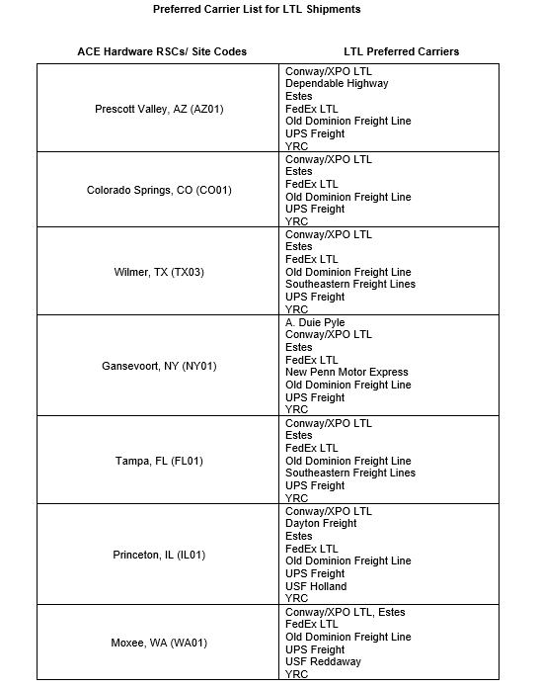
Merchandise Delivered on Preferred Carrier
$75 non-compliance chargeback per P.O.

Slide 52
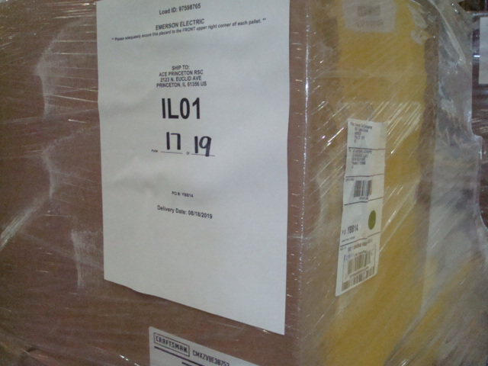
Shipping through an Ace Cross Dock
Prepare Master Bill of Lading
  List all POs on the shipment.
  PO numbers, Number of pallets, Weight & Cross Dock location
Prepare a Memo Bill of Lading for each PO
  PO number, Number of Pallets, Number of Cartons, Weight & Ace RSC location
Label each pallet with the BluJay placard

Slide 53
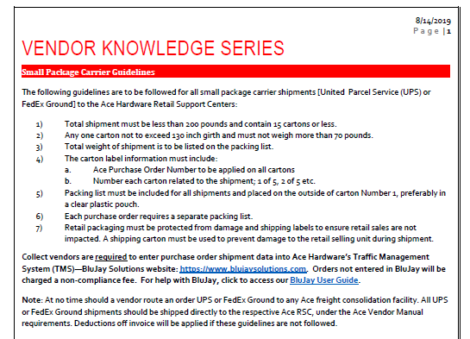
Small Package Guidelines
$75 non-compliance chargeback per PO

Slide 54
How Ace Can Help
Assist New Vendors on initial shipments to Ace RSCs
Assist with pallet configurations for Promotional shipments, Seasonal Buys, High velocity items
Review and approve paperwork enhancements – packing lists, pallet labeling, etc.
One-on-One Vendor Meeting at Ace RSC to review your shipment for any QR issues or areas for improvement
Help facilitate RSC visit to other Ace RSCs

Slide 55
Call to Action
Communicate Ace Shipping Requirements to each of your shipping facilities (including 3 PLs)
Contact us for Promotional shipments, Seasonal Buys
Communicate any system upgrades or enhancements – keep in mind any programming needs for packing lists, pallet labeling, etc.
Audit shipments to Ace periodically for QR compliance – increased focus on # 3, 4, 5, & 6 – greatest areas of non-compliance

Slide 56
Want to Know More?
Contact Information:
Laurie Nauman
Sr. Supply Chain Coordinator
lnaum@acehardware.com
PH: 815-876-2584
Resources:
www.acehardware-vendors.com
Domestic Vendor Manual
E-Tools > Vendor Compliance > Quick Response

Slide 57
Questions?

Slide 58
Ace Corporate Inbound Traffic
Adam Maus, Transportation Planner

Slide 59
Agenda & Objectives
Agenda
Distribution Locations
Collect Vendors
BluJay Solutions
Prepaid Vendors
Vendor Chargebacks
Call to Action
Resources
Objectives
Provide knowledge to vendors to make routing as simple as possible while avoiding scenarios that may cause chargebacks or routing issues.

Slide 60
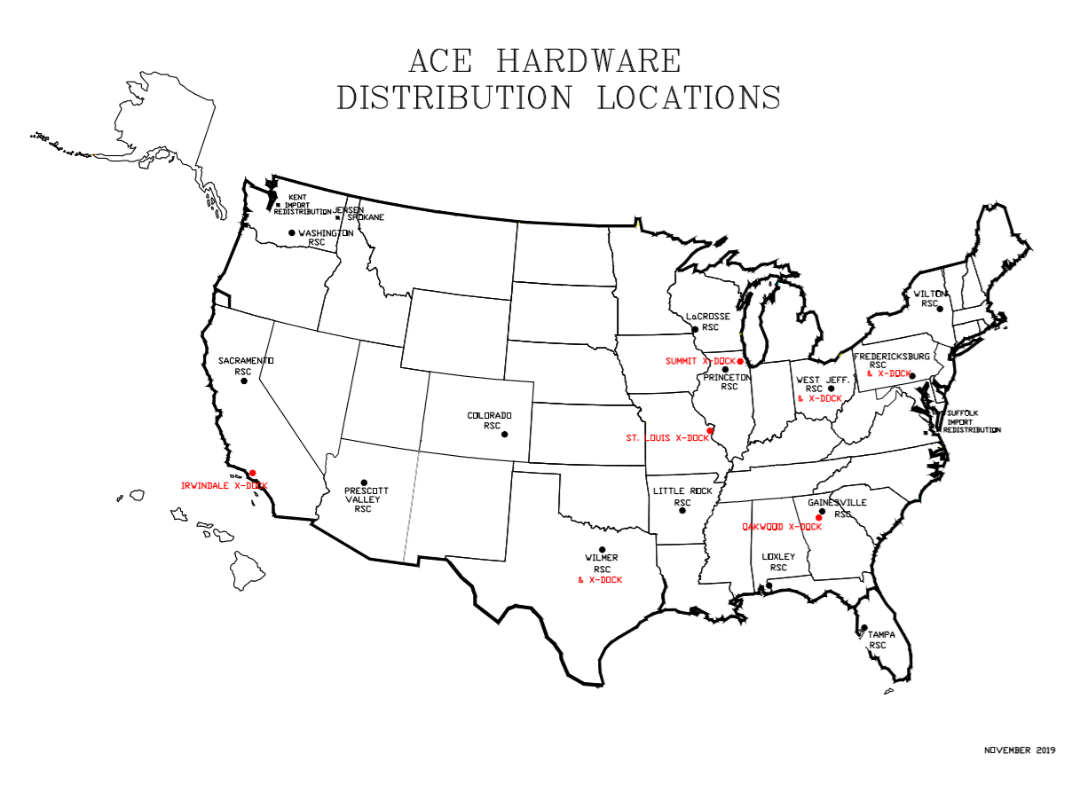
Distribution Locations

Slide 61
Collect Vendors
Routing – BluJay Solutions
Consolidation Centers (Crossdocks)
  Master bill of lading
  Placards
Small Parcel
  Less than 200 lbs. / 130 inches girth/ 15 boxes or less
Pickup appointments
  Truckload: Carrier schedules
  Less than truckload: Vendor schedules

Slide 62

BluJay Solutions
Access to BluJay
  Contact inboundtraffic@acehardware.com
Ready to Ship Date
  Require 72 hour notice
  Add multiple orders at once
Ship from Address
Shipment details
Haz Mat
Load advisors

Slide 63
Prepaid Vendors
Ace Hardware Routing Guide
Parcel Shipments
  Less than 200 lbs. / 130 inches girth/ 15 boxes or less
Less Than Truckload
  201 lbs. to 10,000 lbs.
  Less than 750 cubic feet
  Preferred carrier list
Truckload
  Carrier of vendor’s choice
  Delivery appointment required at RSC

Slide 64
Chargebacks
NPC- Non Preferred Carrier
OSP- Over dimension parcel shipments
Bill of lading and accessorial errors
  Which includes direct shipments, driver delays, truck order not used, re-works, freight terms

Slide 65

Call to Action
Review vendor manual
Review routing guide
Review BluJay user guide

Slide 66
Want to Know More?
Contact:
inboundtraffic@acehardware.com
Reference: www.acehardware-vendors.com
Vendor Manual: www.acehardware-vendors.com > Become a Domestic Supplier
Routing guide: e-tools> Inventory & Supply Chain > Transportation & Traffic
BluJay User guide: e-tools > Inventory & Supply Chain > Transportation & Traffic
Notes:
Print out pages of our vendor manual?

Slide 67
Questions?

Slide 68
Inventory & Demand Planning
Nick Pappanduros, Demand Planning Department Manager

Slide 69
Agenda & Objectives
Agenda
Inventory Metrics and Goals (WIGs)
Inventory Organization & Systems
Demand Planning and Replenishment Planner Overview
Purchase Projections
Best Practices and Call to Action
Objectives
To help you understand what inventory management goals are important to Ace.
To give you an understanding of basic Inventory/Demand practices at Ace.
Let you know the most important things you can do to help us be successful.

Slide 70
Inventory – Wildly Important Goals
96.9%
4.88
Service Level
Inventory Turnover
Other key Metrics
  Forecast Error (WMAPE) – 1 week and 4 week views.
  Overstock dollars
  Vendor OTIF with backorders.

Slide 71
Organization & Systems
35 Replenishment Planners, 8 Demand Planners
  Approximately 2800 vendors, 120k SKUs, 1M DFUs
Systems
  ERP: SAP
  Demand Planning: JDA Demand
  Import replenishment: JDA Fulfillment
  Domestic replenishment: JDA E3/AWR (Migrating to JDA Fulfillment)
#1 priority is service to our retailers!

Slide 72
Demand Planning Overview
1M forecasts managed by 8 demand planners
  Forecasting is done at the item-RSC (i.e. warehouse) level
  Planners are aligned with merchant departments
Weekly wholesale demand forecasts
  Drop ship, and non-stock item demand is not included.
  Promotional bulletins are included, show bulletins are not.
  Promotional planning is handled separately by replenishment teams
Several forecasting algorithms available
  Algorithms take into account trend and seasonality
  Use up to three years of history.

Slide 73

Promotional Forecasting
Advertising Cycle
  Plan inventory 5 months in advance
  97.7% promo service level goal/attained
  Post promotional review process and course corrections
Promotional Planning – Future:
  Retail Inventory Visibility
  Deep dive on causal factors that influence demand

Slide 74
Ace Replenishment Approach
Forecast is the base for all items/categories.
Basic Items
  Order point - Lead time + Safety stock
  EOQ - Balance cost of purchasing with cost of carrying inventory.
Seasonal Items
  Seasonal S&OP Planning. Always plan for a strong season!
  Adjust during season based on weather.
Promotional Items
  Forecasted separately and layered into plan.

Slide 75
Safety Stock and Order Cycle
Safety stock is set using statistical methodology
  Service goal is set for each Item/RSC based on item ABC class
  Safety stock days are calculated based on service goal, forecast error, lead time error, overall lead time, and other minor factors.
  Statistical SS can be supplemented with “holds” of additional quantities to accommodate unique circumstances such as seasonality.
Order frequency is based on standard EOQ logic.
  EOQ balances cost of carrying inventor with cost of placing, processing, and receiving PO’s (including freight).
  A vendor level order cycle is calculated to determine PO frequency.
  An item level order cycle is calculated for item order frequency.

Slide 76

Lead Time
Lead time observations gathered at item/RSC/PO level
Moving average is recalculated each month for every RSC/Vendor/Sub-vendor combination.
Results are tracked and monitored for each lead time component :
      EDI PO acknowledgement
      Vendor processing days
      Ready to ship and ASN
      Carrier pick up and cross dock dwell
      Delivery to RSC and actual receipt

Slide 77
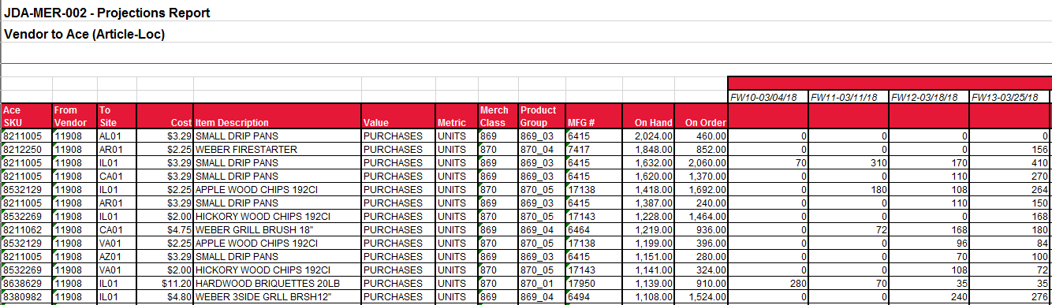
Vendor Purchase Projections
Projected purchases by Ace shown in 52 weekly buckets
  On Ace vendor portal) ADW Reporting → Product tab → Vendor Projections
  Updated weekly on Monday morning.
  Available in units, dollars, cube, weight (Item-RSC level or Item level)
*Look for an upcoming webinar*

Slide 78

Vendor Purchase Projections
What goes into them?
  Wholesale baseline forecasts from JDA Demand
  Current on hand/on order position
  Promotional Forecasts
    Promotional forecasts uploaded approx. 5 months out
    Communicate with replenishment teams on timing of promotional forecasts (be mindful of production lead times)
  Safety stock, order cycles, and lead time expectation.
  Item order multiples and convenience packs in replenishment systems

Slide 79
Vendor Purchase Projections
Limitations
  PO order minimums are not considered.
  Demand for retailer drop ship orders or bulletin(pre-order) quantities prior to retailer ordering window close date
  Assumes vendor is able to ship in full
  It is just a forecast
    Not an obligation to buy
    Vendors should do their own internal forecasting and only use Ace’s projections as a point of comparison.

Slide 80
Network Changes
Network changes are planned in advance and are reflected in purchase projections.
  New items may be set up.
Store Moves are frequently made to balance capacity.
Recent or planned moves:
  Opening of Fredericksburg PA RSC in 2019. Along with closure of Prince George, VA and consolidation of former Emery facilities.
  OH expansion to full service (versus full case CDX) completed Q1 2019
  TX expansion to full service (versus full case CDX) expected completion Q4 2020

Slide 81

Vendor Forecasting Best Practices
Utilize Ace’s Purchase Projection as Input to the overall Process – Monthly
Utilize a Statistical Forecasting System
Leverage 36 months history to consider seasonality
Highlight variances to Ace’s forecast. Lead the conversation
Leverage an Integrated business plan - S&OP
Notes:
Improve relationship and process w/strategic partners
Understand what’s most important to the supplier
Ensure that Ace’s vision and objectives are clear
Create cross functional collaboration to deliver on target

Slide 82
Call to Action
Alert your Ace replenishment contact of any network or system changes
  ERP/WMS changes, warehouse moves, inventory shutdowns, etc.
New items need to be set up properly
Submit change paperwork in advance
  30 days for article change requests, 90 days for pricing changes
Check Lost Sales on www.acehardware-vendors.com.
  You can see the items that are impacting your service
  Check this report frequently

Slide 83
Call to Action
Book orders into BluJay (Lean) on time
  Impacts metrics and inventory performance.
Communicate backorders and estimated ship dates
  This date drives many systems throughout Ace.
Do not hold orders for backorders. Ship what you can by the requested ship date.
Run the purchase projections.
  Not a replacement for your own forecast but a supplement.

Slide 84
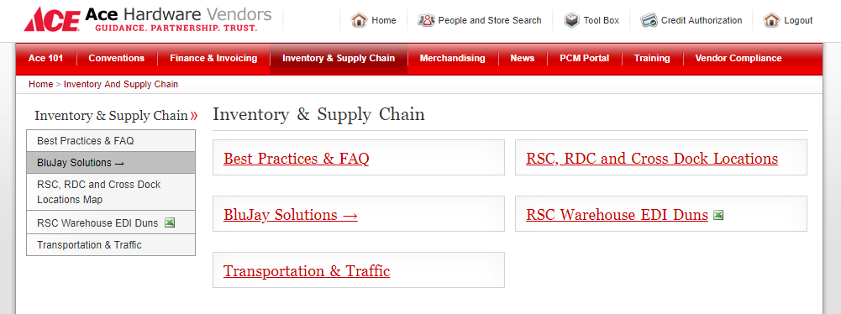
Want to Know More?
Contact Information
  Please contact your Demand or Replenishment Planners
    www.acehardware-vendors.com > E-Tools Login > Ace 101 > Contacts > Planner Listing
Resources
  For more information about Inventory/Demand, please visit www.acehardware-vendors.com > E-Tools Login > Inventory & Supply Chain.

Slide 85
Questions?

Slide 86
Supply Chain
Stacey Furey, Senior Manager, Supplier Performance

Slide 87

Agenda & Objectives
Agenda
OTIF: On Time In Full
Compliance and Assessments Policy
Resources for Vendors
  Supplier Dashboard
  Supplier Scorecard
  Vendor Assessments Portal
Objectives
To help you understand Ace Hardware’s vendor shipping performance requirements

Slide 88
OTIF: On Time In Full
OTIF: A unit level fill rate measurement that includes the element of timeliness
Total quantity of all units shipped no later than 2 calendar days past the requested ship date, divided by the total quantity of all units ordered on the original Purchase Order
Requested Ship Date is systematically calculated based upon a vendor’s order processing days. Ace’s standard vendor order processing time is 3 business days or less.
Order processing days are measured in business days only. Because Ace purchase orders are sent via overnight EDI processing, Day 1 is considered to be the 1st business day after PO creation by Ace.
** IMPORTANT:
OTIF IS SPECIFIC TO RSC PURCHASE ORDERS ONLY
# of Units Shipped by Ace’s Requested Ship Date + 2 calendar day grace
# of Units Ordered

Slide 89

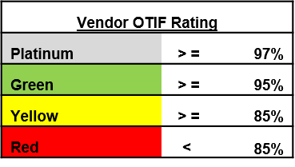
OTIF: On Time In Full
Ace utilizes the EDI ASN 856 as record of the vendor’s units shipped and shipment dates. Thus, EDI accuracy and timeliness is critical.
The EDI ASN 856 must be sent on the date of shipment to ensure OTIF accuracy.
Sending 100 units on time, without an ASN = Not sending 100 units

Slide 90
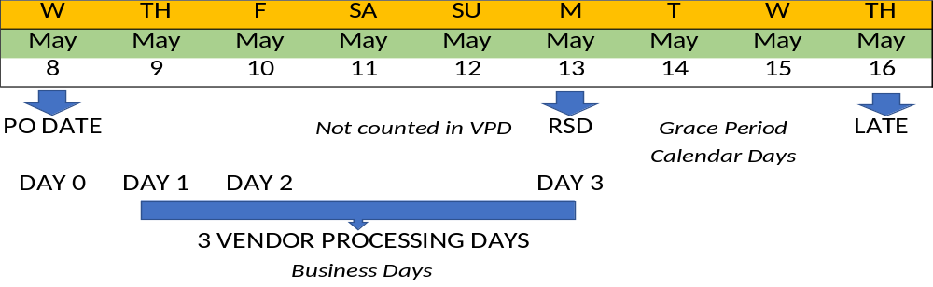
OTIF Calculation Example
1
Ship On Time
100% Fill Rate
%
75 Units On Time | = | 75% OTIF
100 Units Ordered
100 Units Late | = | 0% OTIF
100 Units Ordered

Slide 91
Vendor Compliance
Ace
Pickups
Appointments
Supplier
Planning
Execution
Systems
Understanding
Ace Delays in Pickup (COL Freight Vendors):
Enter your load into BluJay TMS as Ready to Ship on time
Send your ASN when the truck leaves
** Adhering to these 2 steps allow us to remove DIP from your OTIF score **
RSC Appointment Delays (PPD Freight Vendors):
Unable to remove from OTIF scores
Can be manually excluded from OTIF charges
** Maintain documentation of appointment issues **

Slide 92
Vendor Compliance
Late Shipments have a significant impact on Ace Operations, AND decrease the chance that our customers find your products on our shelves!
Increased Costs
Lost Retail Sales
More Inventory
Expediting and Monitoring Efforts
Transportation Issues
RSC Efficiency

Slide 93
Vendor Compliance
Ace processes 3 types of chargebacks related to Late/No Shipments and Backorders
Financial assessments are processed monthly as a chargeback against an invoice payment to the vendor by Ace
Late Shipment Chargebacks (OBLS)
  Based upon vendor’s OTIF score for the month
Monthly OTIF Score | Assessment
> = 95% | No Assessments on Late/No Ships occurring in the previous month
> = 85% and < 95% | 3% of PO Line Cost of Units Not Shipped within grace period
< 85% | 6% of PO Line Cost of Units Not Shipped within grace period
  ASN data is used to determine actual ship dates and quantities shipped
        EDI Accuracy and timeliness is critical

Slide 94
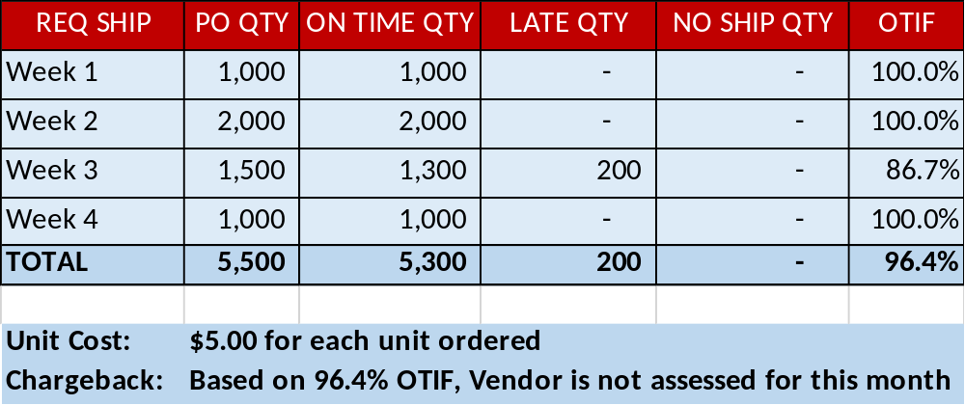



Late Shipment Chargeback Examples
Vendor “A” has a score of 96.4% OTIF for August orders
    Vendor A has $0 in financial assessments for the month

Slide 95
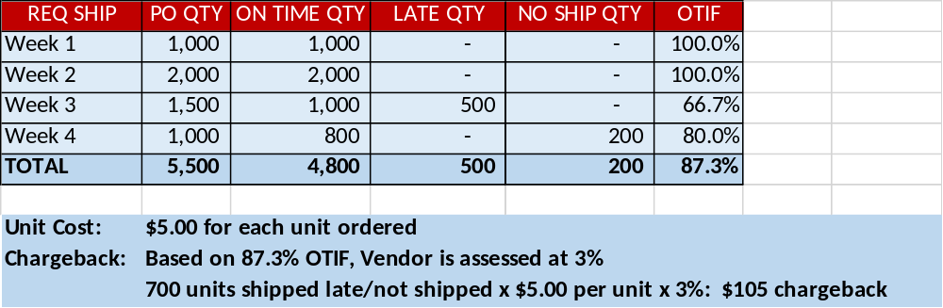
Late Shipment Chargeback Examples
Vendor “B” has a score of 87.3% OTIF for August orders
    Vendor B has $105 in financial assessments for the month

Slide 96
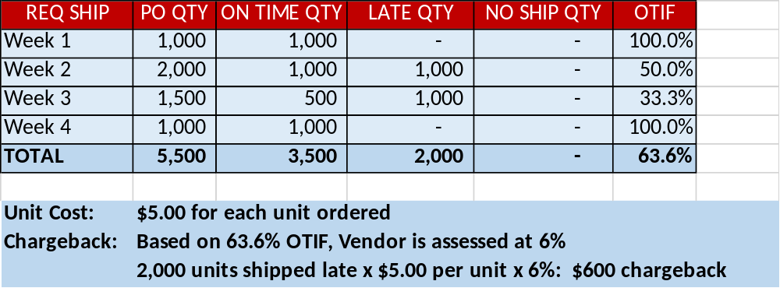
Late Shipment Chargeback Examples
Vendor “C” has a score of 63.6% OTIF for August orders
    Vendor C has $600 in financial assessments for the month

Slide 97
Vendor Compliance
Backorder Chargebacks (OBBKO)
  Any units remaining on backorder status beyond 1 week will incur a chargeback of 3% of the original Purchase Order line cost of those units, regardless of a vendor’s monthly OTIF results
  Calculated on a weekly basis and assessed on a monthly basis
  A vendor may incur both Late Shipment and Backorder chargebacks in a single month
  There is no limit to the number of weeks that an open backorder will be assessed a chargeback

Slide 98
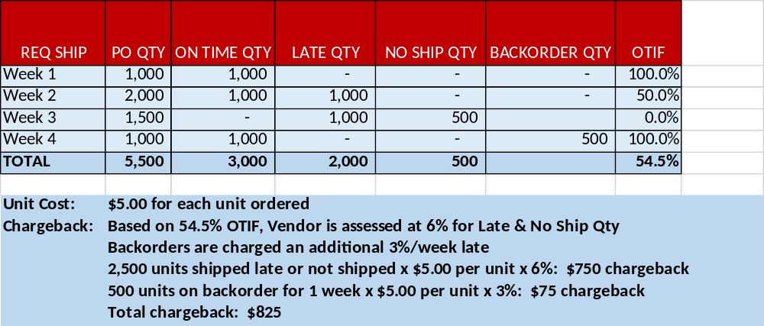
Backorder Chargeback Examples
Vendor “A” has a score of 54.5% OTIF for August orders
    Vendor A has 500 units on backorder in week 4 (from an order that was to ship in week 3)
    Vendor A has $825 in financial assessments for the month

Slide 99
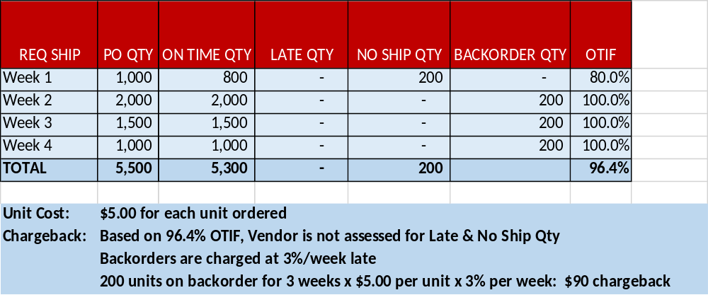
Backorder Chargeback Examples
Vendor “B” has a score of 96.4% OTIF for August orders
    Vendor B has 600 units on backorder in weeks 2, 3, and 4 (from an order that was to ship in week
    Vendor B has $90 in financial assessments for the month

Slide 100

Vendor Compliance
Backorder Freight Reimbursement Fees (OBBOF)
  Ace has a specific policy for shipment of backorders, related to freight terms:
    All backorders must be consolidated and shipped on a Prepaid freight basis unless authorized by the Ace Merchant or Inventory team
    If a vendor arranges through Ace Transportation to ship backorders on a Collect freight basis, Ace will process monthly chargebacks for reimbursement of the freight costs associated with the backordered portion of the total shipment
  How to Avoid Backorder Freight Reimbursement Fees
  Ship in full with no backorders
  Ship pre-paid to fulfill a backorder
    Parcel shipments into Ace Crossdock facilities are not allowed

Slide 101
Summary of Vendor Compliance Chargebacks
  OBLS: Late / No Shipment Chargeback
    Based upon your OTIF score for the month, either 3% or 6% of the PO Line Cost of the goods not shipped
  OBBKO: Backorder Chargeback
    Units on backorder status beyond 1 week incur a chargeback of 3% of the PO line cost of those units, regardless of a vendor’s monthly OTIF results
    Calculated every week
  OBBOF: Backorder Freight Reimbursement
    Collect Freight Vendors are responsible for paying the shipping charges for all backordered items on RSC purchase orders

Slide 102
Dispute Process
AceVendorCareCenter@acehardware.com
630-990-2777
Disputes are only considered if filed through the Ace Vendor Care Center within 90 days of the remittance date of the chargeback
Vendors must provide appropriate supporting documentation

Slide 103

Frequently Asked Questions
I had my order ready to ship on time, but Ace was delayed in picking it up. Is my OTIF score affected?
I have a Prepaid (PPD) freight arrangement with Ace. I had my order ready to ship on time, but could not get an appointment at the Ace RSC for several days. This caused me to ship late. Is my OTIF score affected?
I shipped all of the product on time, but my ASN was incorrect (or late, or was not sent). Is my OTIF score affected?
How do I know how my OTIF scores are trending throughout the month?

Slide 104
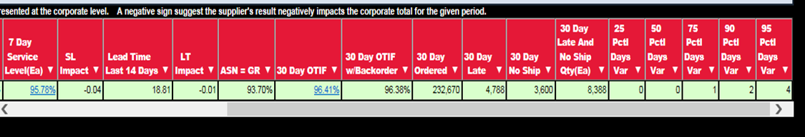
Vendor Resources
Supplier Dashboard
View of key performance indicators related to order fulfillment:
  OTIF performance (previous 30 days)
  Lost Sales (previous 7 Days)
  EDI and ASN performance
  Ace Open Orders
  Ace Collect Shipment Data
  Most recent monthly scorecard

Slide 105
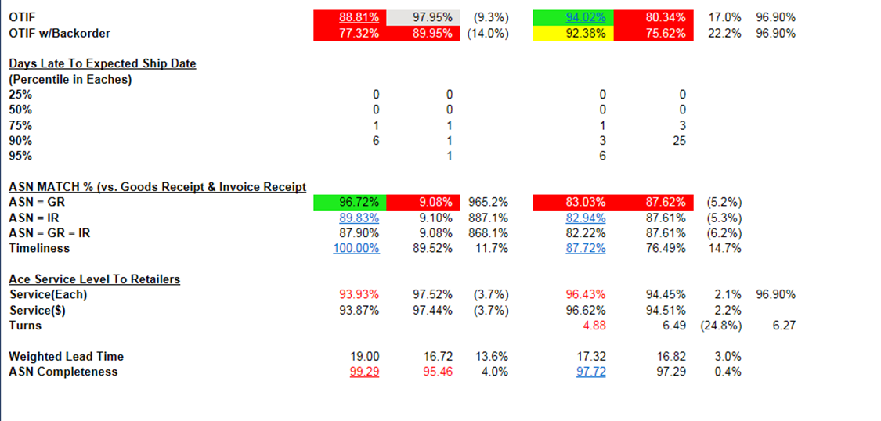

Use hyperlinks to access detailed information for the month or YTD

Slide 106
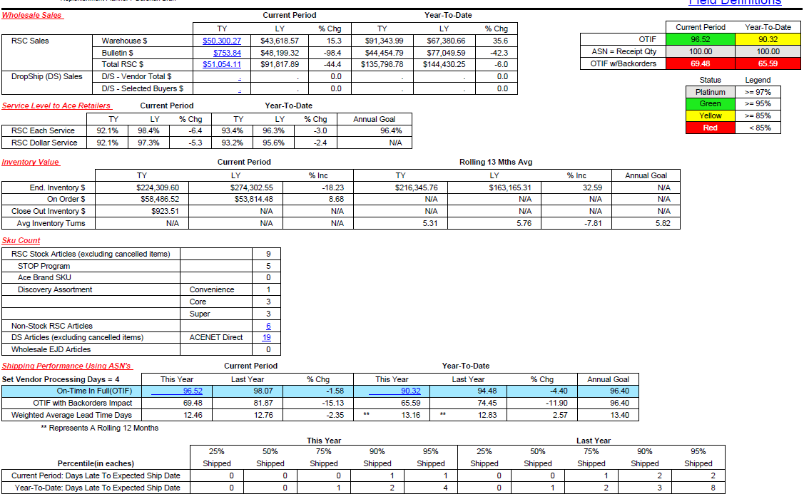
Vendor Resources
Supplier Scorecard
Printable monthly view of key performance indicators, sales data, inventory value, etc
Available by the 5th day of the following month

Slide 107
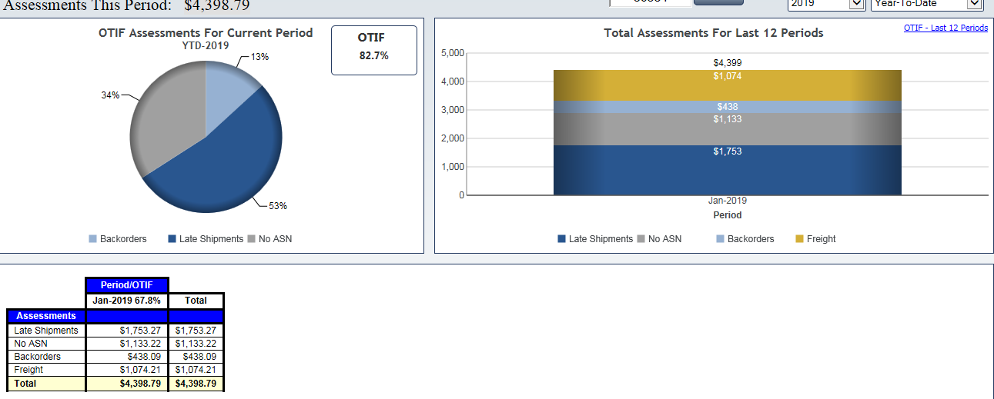
Vendor Resources
Vendor Assessments Portal
PO/Line Level Detail for 3 Vendor Compliance Chargebacks (OBLS, OBBKO, OBBOF)

Slide 108
Call to Action
Review all compliance documentation available on www.acehardware-vendors.com > E-Tools Login > Vendor Compliance > Vendor Assessments
Access the Supplier Dashboard for your vendor number at www.acehardware-vendors.com > E-Tools Login > Tool Box > ADW Reporting > Supply Chain Visibility > Supplier Dashboard
Pull your most recent Vendor Scorecard at www.acehardware-vendors.com > E-Tools Login > Tool Box > ADW Reporting > Supply Chain Visibility > Supplier Dashboard
Review any Chargebacks on the Vendor Assessment Portal.

Slide 109


Want to Know More?
Documentation: Acehardware-vendors.com > E-Tools > Vendor Compliance > Vendor Assessments
  https://apps.acehardware-vendors.com/locations/vendor_compliance/vendor_assessments/index.asp
Chargeback Disputes: Submit through the Ace Care Center
Policy Questions: Contact your replenishment planner or the Ace Supply Chain Team
    Stacey Furey, Sr Manager of Vendor Performance
    sfurey@acehardware.com
    630-990-2768

Slide 110
Want to Know More?
Ace Supply Chain team:
Stacey Furey
sfurey@acehardware.com
DEPT: 1C, 4T, 5E, 5F, 5H, 5R, 5W, 6F, 6G, 6I, 6L, 9K
Tim Malone
tmalo@acehardware.com
DEPT: 2B, 2D, 2H, 2V, 3A, 3C, 3E, 3N, 4D, 4F, 4P, 4Q, 4R, 8Z
Art Krause
akraus@acehardware.com
DEPT: 1A, 1B, 1D, 1P, 1R, 1U, 9M
Trent Vryhof
tvry@acehardware.com
DEPT: 7A, 7D, 7G, 7L, 7O, 7W, 7X, 8B, 8J, 8O, 8P, 9H

Slide 111
Questions?

Slide 112

Closing Comments

