Slide 1
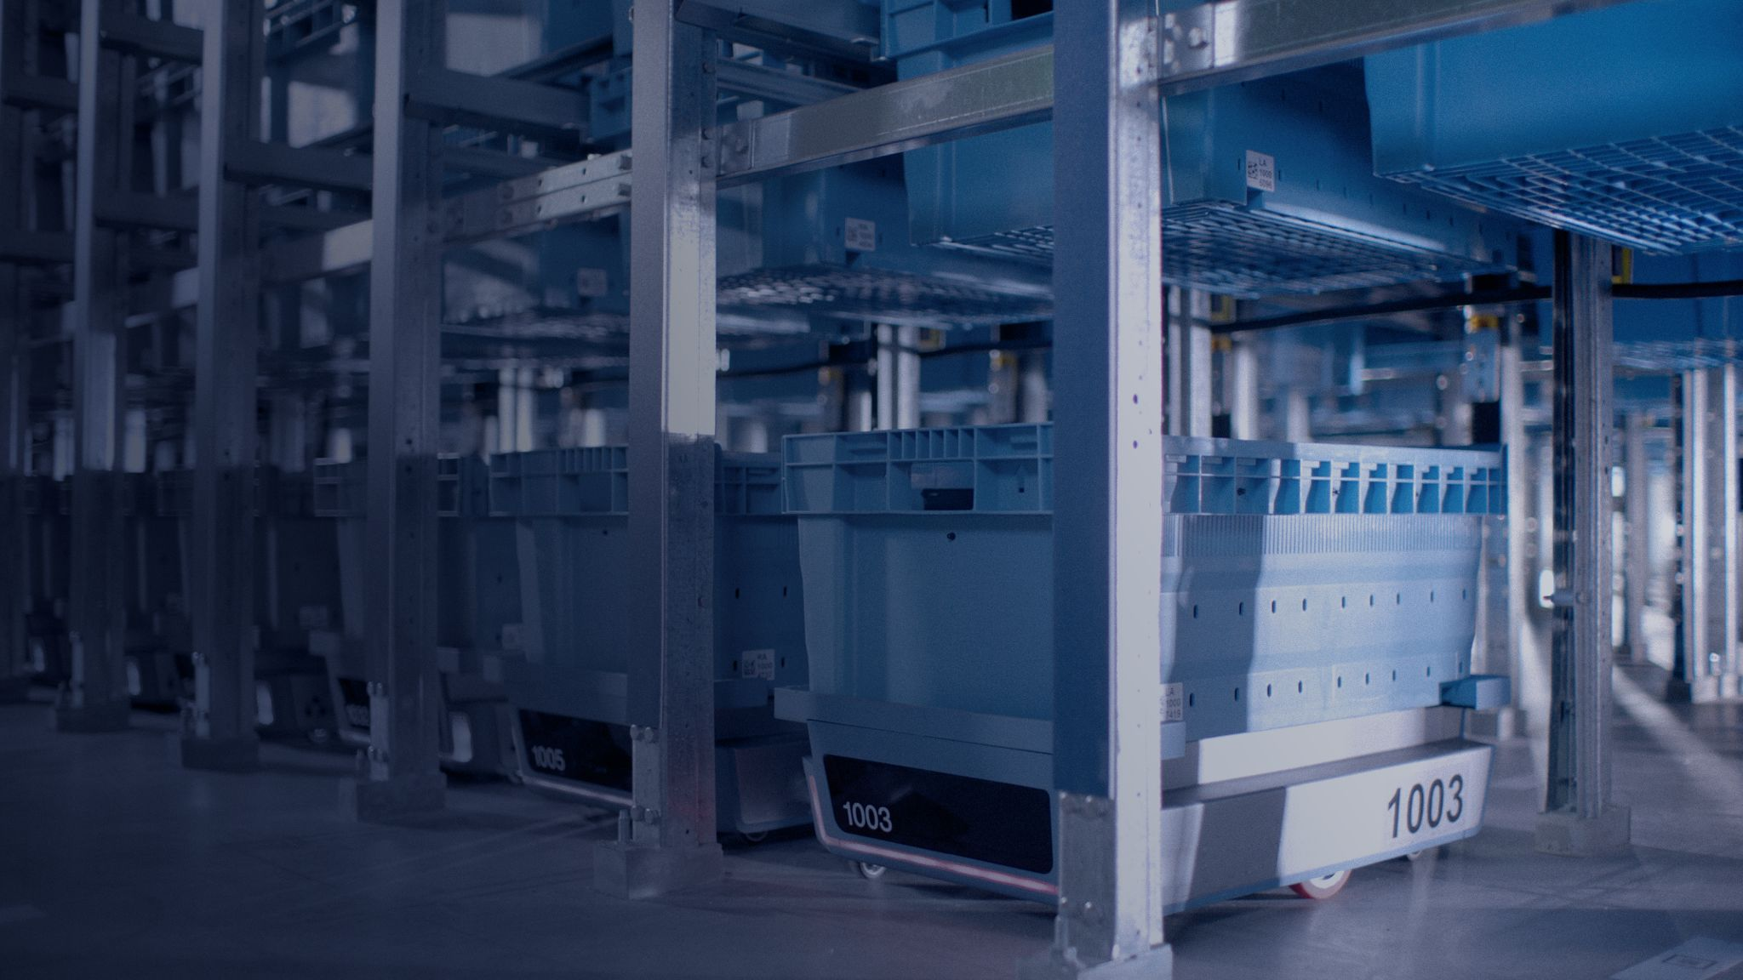

Manual Fulfillment Center
Process Map Visuals

Slide 2

Contents
Printer Driver Task
3
Trailer Dock Release
5
Receiving
8
Putaway/Stow
13
Inventory Management
16
Pick
20
Pack
24
Shipping/Dispatch
28
Quality Control
38
Exceptions
42

Slide 3

Printer Driver Task

Slide 4

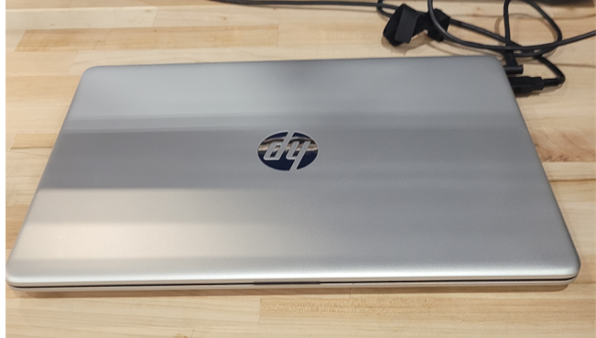
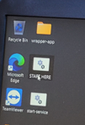
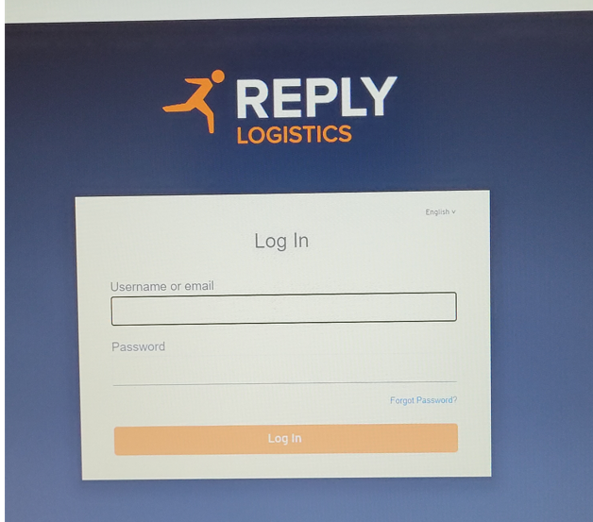
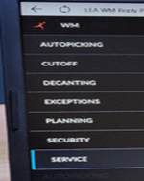
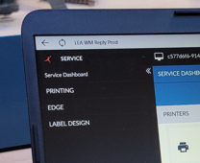
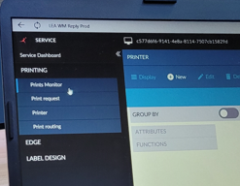
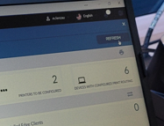
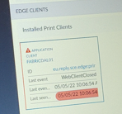
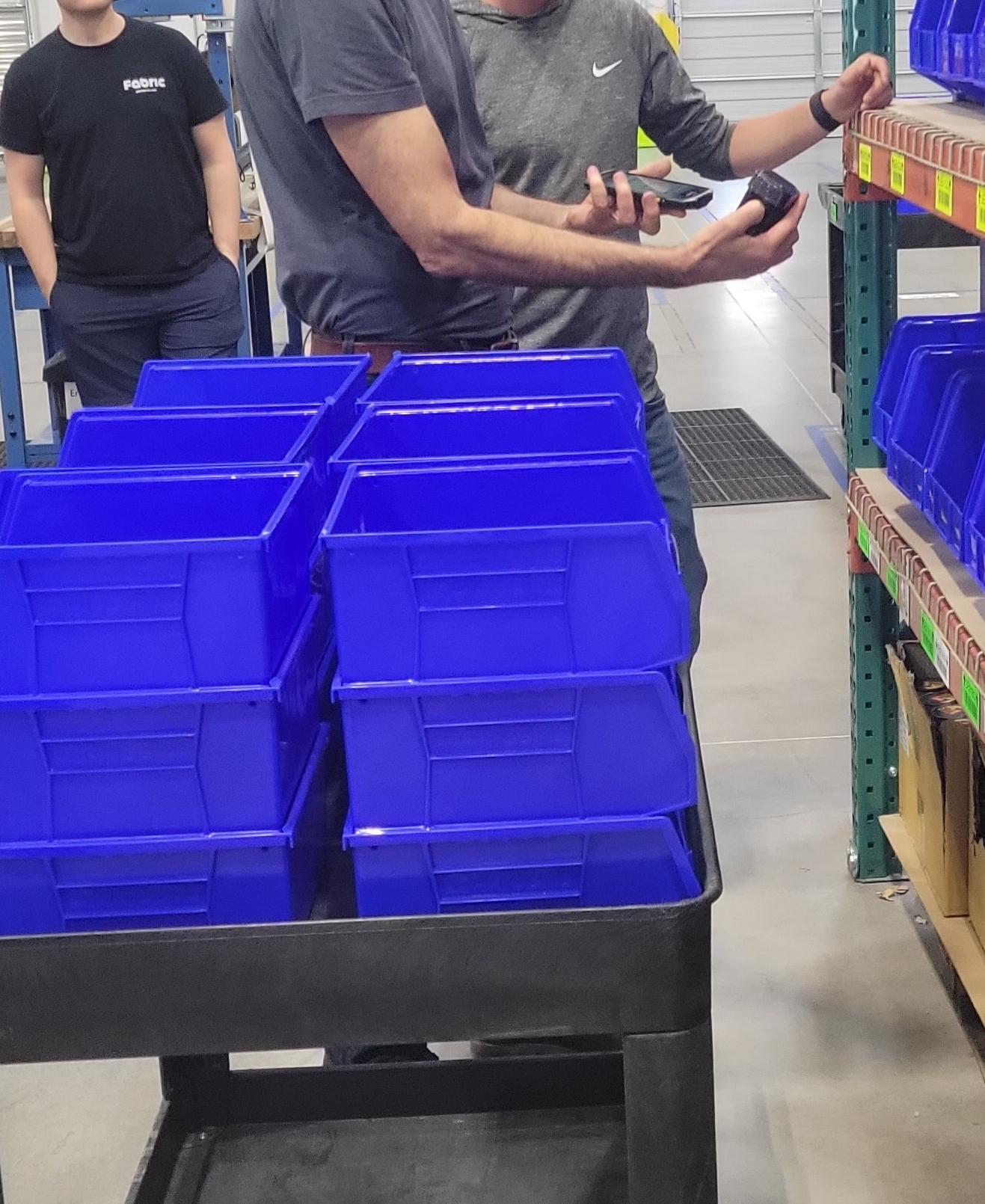
 |  | Printer Driver Daily Task
ID # | PDR01 | Revision # | 01 | Approved by | D.Morton | Location and Freq.
Facility | US | Revision Date | 5/20/2022 | Date | 6/7/2022 | Managers Desk Daily
Document Owner | Site Manager | Other PMVs | Picking by Order
Happy Flow | Log into desktop computer → Double click on START HERE icon → Open LEA → Go to Service → Go to Printing → Select Prints Monitor → Once the application shows a green check mark orders can be picked
Safety Requirements |  | Quality Tips/Definitions
A. Wear cut resistant gloves while manipulating cutter knives and always use proper PPE. |  | A. All product must be visually inspected.
B. If using a pallet jack do not exceed its capacity and do not place feet under pallet jack. |  | B. Contact the Shift Manager about damaged product immediately.
C. Watch your step when walking around manual areas to avoid trips/falls. |  | C. Clean area of visible debris once tasks are complete.
D. Use proper lifting techniques when loading and unloading.
1 | 2 | 3 | 4
Log into the manager’s computer. | Double click on START HERE icon on the home screen. | Log into LEA using the provided credentials. | Select Service from the menu.
5 | 6 | 7 | 8
Select Printing. | Select Prints Monitor. | While the program is running in the background. Refresh screen. | Once the application box has a green check mark, the program is done running.
9
Now orders can be picked.

Slide 5
Trailer Dock Release (TDR)

Slide 6
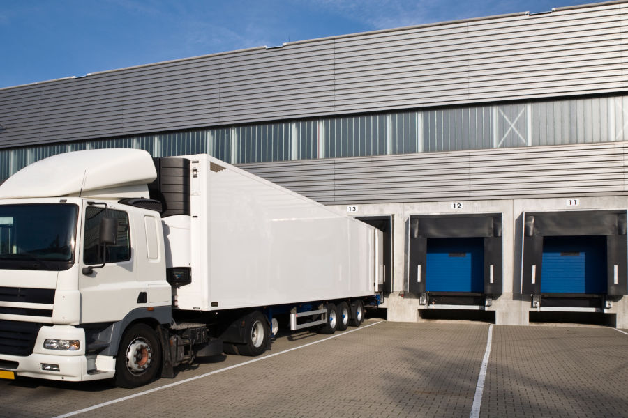

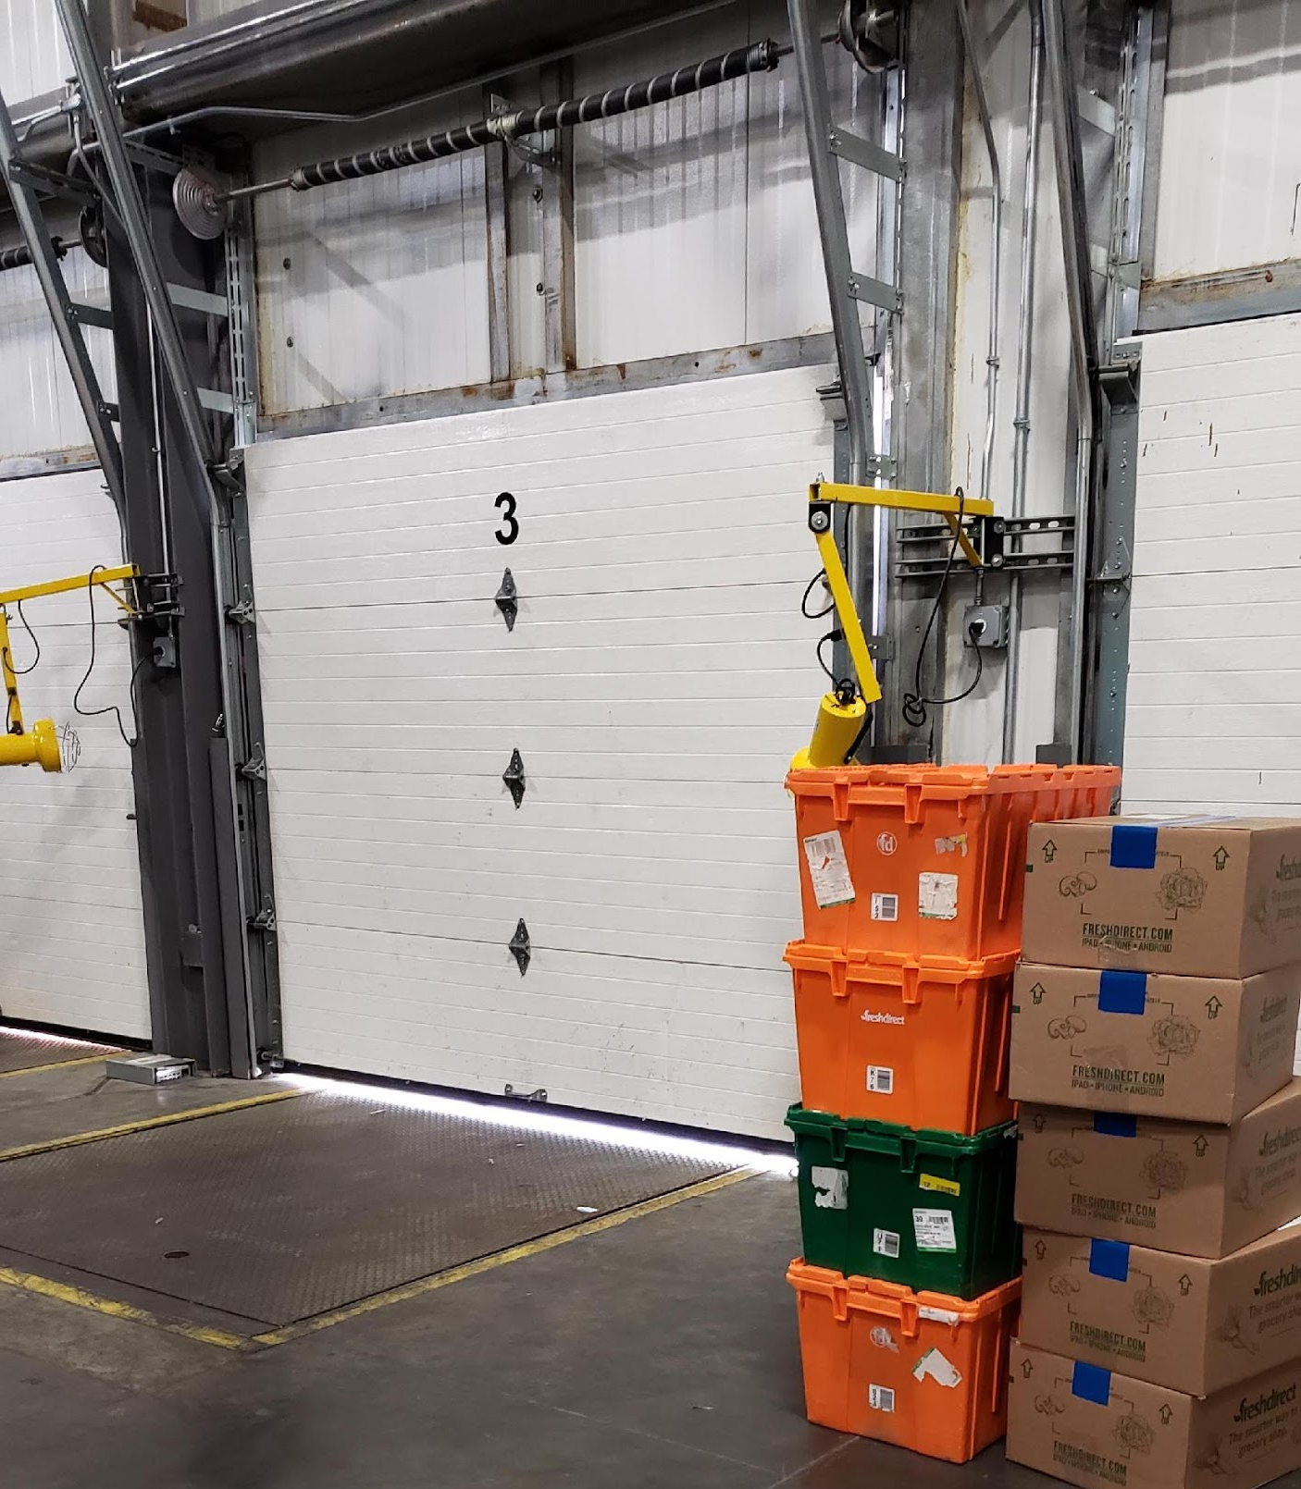
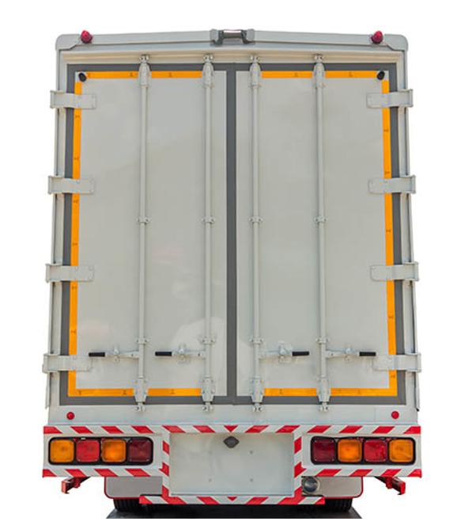

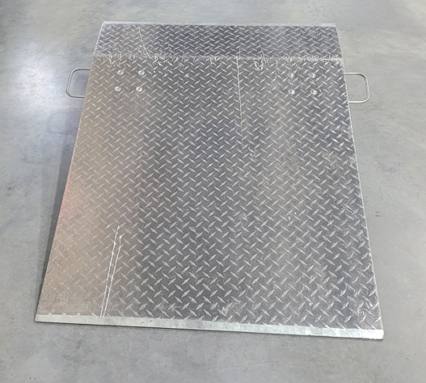
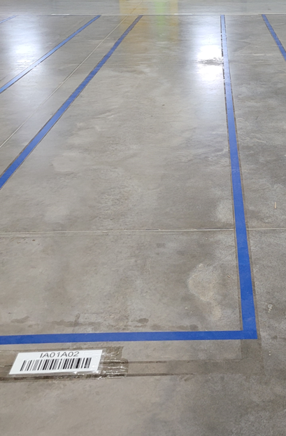

 |  | Trailer Docking: Inbound Arrival
ID # | TDI01 | Revision # | 02 | Approved by | D.Morton | Location and Freq.
Facility | US | Revision Date | 5/20/2022 | Date | 6/7/2022 | Dock Location Every Inbound Delivery
Document Owner | Site Manager | Other PMVs | Trailer Dock Release: Inbound or Outbound Delivery
Happy Flow | Greet Driver → Open dock door → Place dock plate → Place cone → Instruct Driver where to place goods
Safety Requirements |  | Quality Tips/Definitions
A. Wear cut resistant gloves while manipulating cutter knives and always use proper PPE. |  | A. While unloading product, check for visual damage to pallet, boxes, or products.
B. If using a pallet jack do not exceed its capacity and do not place feet under pallet jack. |  | B. Contact the Shift Manager about damaged product immediately.
C. Watch your step when walking around manual areas to avoid trips/falls. |  | C. Clean area of visible debris once tasks are complete.
D. Use proper lifting techniques when loading and unloading.
1 | 2 | 3 | 4
Delivery Driver arrives on site and backs trailer to assigned door. | Delivery Driver is greeted by MFC staff. | Receiving Operator will open dock door. | Delivery Driver will open trailer door.
5 | 6 | 7 | 8
Receiving Operator places a green cone in front of truck and will chock the trailer tires. | Receiving Operator will place the dock plate over the gap between the trailer and the warehouse floor. | Receiving Operator will instruct Delivery Driver where to place goods. Delivery Driver will place goods in Inbound staging area. | Did you make a mistake? Let your Shift Manager know immediately.

Slide 7


 |  | Trailer Dock Release: Inbound or Outbound Delivery
ID # | TDR01 | Revision # | 02 | Approved by | D.Morton | Location and Freq.
Facility | US | Revision Date | 5/20/2022 | Date | 6/7/2022 | Dock Location Every Inbound or Outbound Delivery
Document Owner | Site Manager | Other PMVs | Trailer Docking: Inbound Arrival Receive: Driver Arrives Onsite
Happy Flow | Remove dock plate → Close dock door → Remove cone → Shift Manager retrieves paperwork or signs Driver paperwork → Driver leaves dock
Safety Requirements |  | Quality Tips/Definitions
A. Wear cut resistant gloves while manipulating cutter knives and always use proper PPE. |  | A. While unloading product, check for visual damage to pallet, boxes, or products.
B. If using a pallet jack do not exceed its capacity and do not place feet under pallet jack. |  | B. Contact the Shift Manager about damaged product immediately.
C. Watch your step when walking around manual areas to avoid trips/falls. |  | C. Clean area of visible debris once tasks are complete.
D. Use proper lifting techniques when loading and unloading.
1 | 2 | 3 | 4
Operator removes dock plate. | Driver will close trailer door. | Operator will close dock door. | Operator removes green cone from in front of truck.
5 | 6 | 7 | 8
Let the Shift Manager know that the Driver is ready for any required paperwork. | Shift Manager will sign any required paperwork. | Driver is free to leave the dock. | Did you make a mistake? Let your Shift Manager know immediately.

Slide 8

Receiving

Slide 9
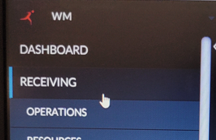
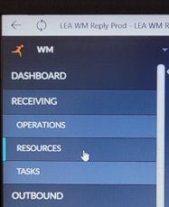
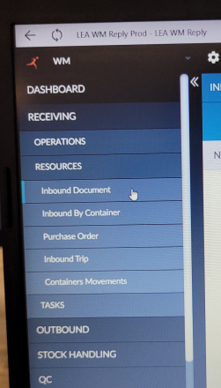
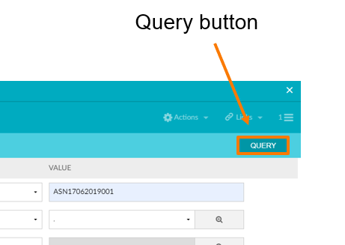
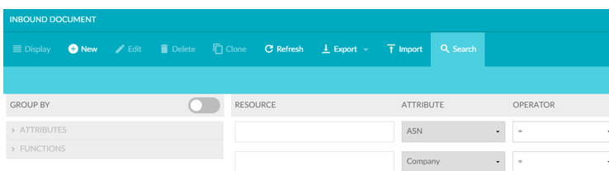
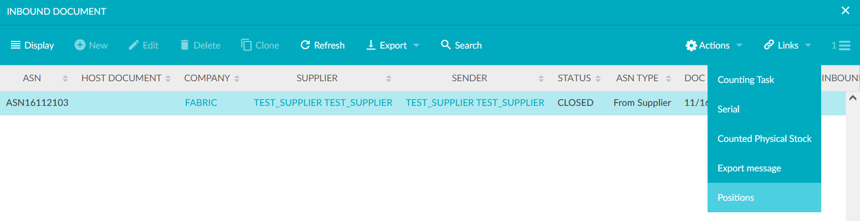
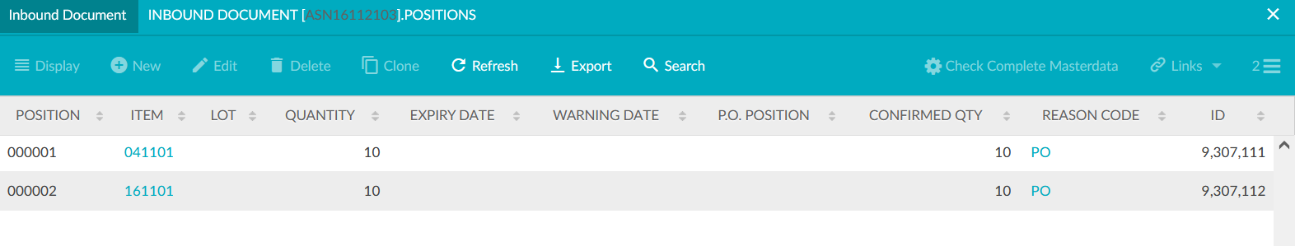
 |  | Receive: Prior to Driver Arrival
ID # | RRC01 | Revision # | 02 | Approved by | D.Morton | Location and Freq.
Facility | US | Revision Date | 5/20/2022 | Date | 6/7/2022 | Shift Manager Workstation Every Inbound Shipment
Document Owner | Site Manager | Other PMVs | Trailer Dock Release: Inbound or Outbound Delivery Receive: Driver Arrives On Site
Happy Flow | Sign into LEA → Look at new inbound documents (ASN) → Look at item(s) and quantities that will arrive → Prepare MFC for arrival
Safety Requirements |  | Quality Tips/Definitions
A. Wear cut resistant gloves while manipulating cutter knives and always use proper PPE. |  | A. All product must be visually inspected.
B. If using a pallet jack do not exceed its capacity and do not place feet under pallet jack. |  | B. Contact the Shift Manager about damaged product immediately.
C. Watch your step when walking around manual areas to avoid trips/falls. |  | C. Clean area of visible debris once tasks are complete.
D. Use proper lifting techniques when loading and unloading.
E.
1 | 2 | 3 | 4
Shift manager goes to desktop computer and signs into LEA platform. | Select Receiving from menu. | Select Resources. | Select Inbound Document.
5 | 6 | 7 | 8
Enter search information. It is recommended to use the ASN here. | Select Query. | Select inbound document Select Links, then Position. | This will show the item(s) and quantities within the PO. Order any equipment needed for new item(s) and prepare area(s) for arrival.

Slide 10
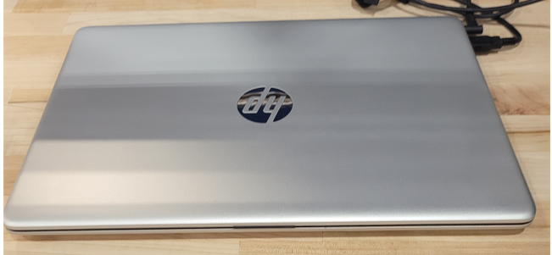
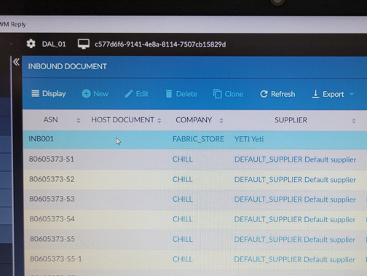
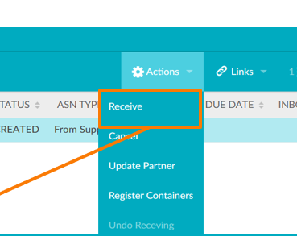
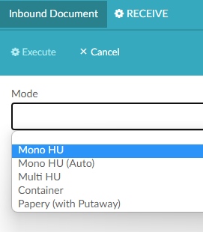

 |  | Receive: Driver Arrives Onsite
ID # | RRC02 | Revision # | 02 | Approved by | D.Morton | Location and Freq.
Facility | US | Revision Date | 5/20/2022 | Date | 6/7/2022 | Receiving Area Every Inbound Receipts
Document Owner | Site Manager | Other PMVs | Receive: Prior To Driver Arrival Receive: Counting Process
Happy Flow | Greet Driver → Sign into LEA → Go to Inbound Documents → Select Receive → Select counting method → Check for damage → Shift Manager signs documents → Driver leaves dock
Safety Requirements |  | Quality Tips/Definitions
A. Wear cut resistant gloves while manipulating cutter knives and always use proper PPE. |  | A. All product must be visually inspected.
B. If using a pallet jack do not exceed its capacity and do not place feet under pallet jack. |  | B. Contact the Shift Manager about damaged product immediately.
C. Watch your step when walking around manual areas to avoid trips/falls. |  | C. Clean area of visible debris once tasks are complete.
D. Use proper lifting techniques when loading and unloading.
E.
1 | 2 | 3 | 4
Delivery Driver arrives on site, greeted by staff and informed where to place inbound products. Receiving Operator ensures TDR procedures are followed. | Delivery Driver unloads products and places them in the Inbound staging area. | Shift Manager goes to desktop computer and signs into LEA platform. | Select Receiving from the menu. Select Resources.
5 | 6 | 7 | 8
Select Inbound Documents. | Select the Inbound Document that is being received. The document must be in Created status to receive it. | Select Actions drop-down menu and select Receive. | Select Mono HU from the drop-down menu as the counting mode. Then select Execute.
9 | 10 | 11 | 12
Receiving Operator inspects all pallet(s) for visible damage. | Shift Manager signs delivery document and gives to Delivery Driver. | Receiving Operator ensures that all TDR procedures are followed during departure. | Did you make a mistake? Let your shift manager know.

Slide 11
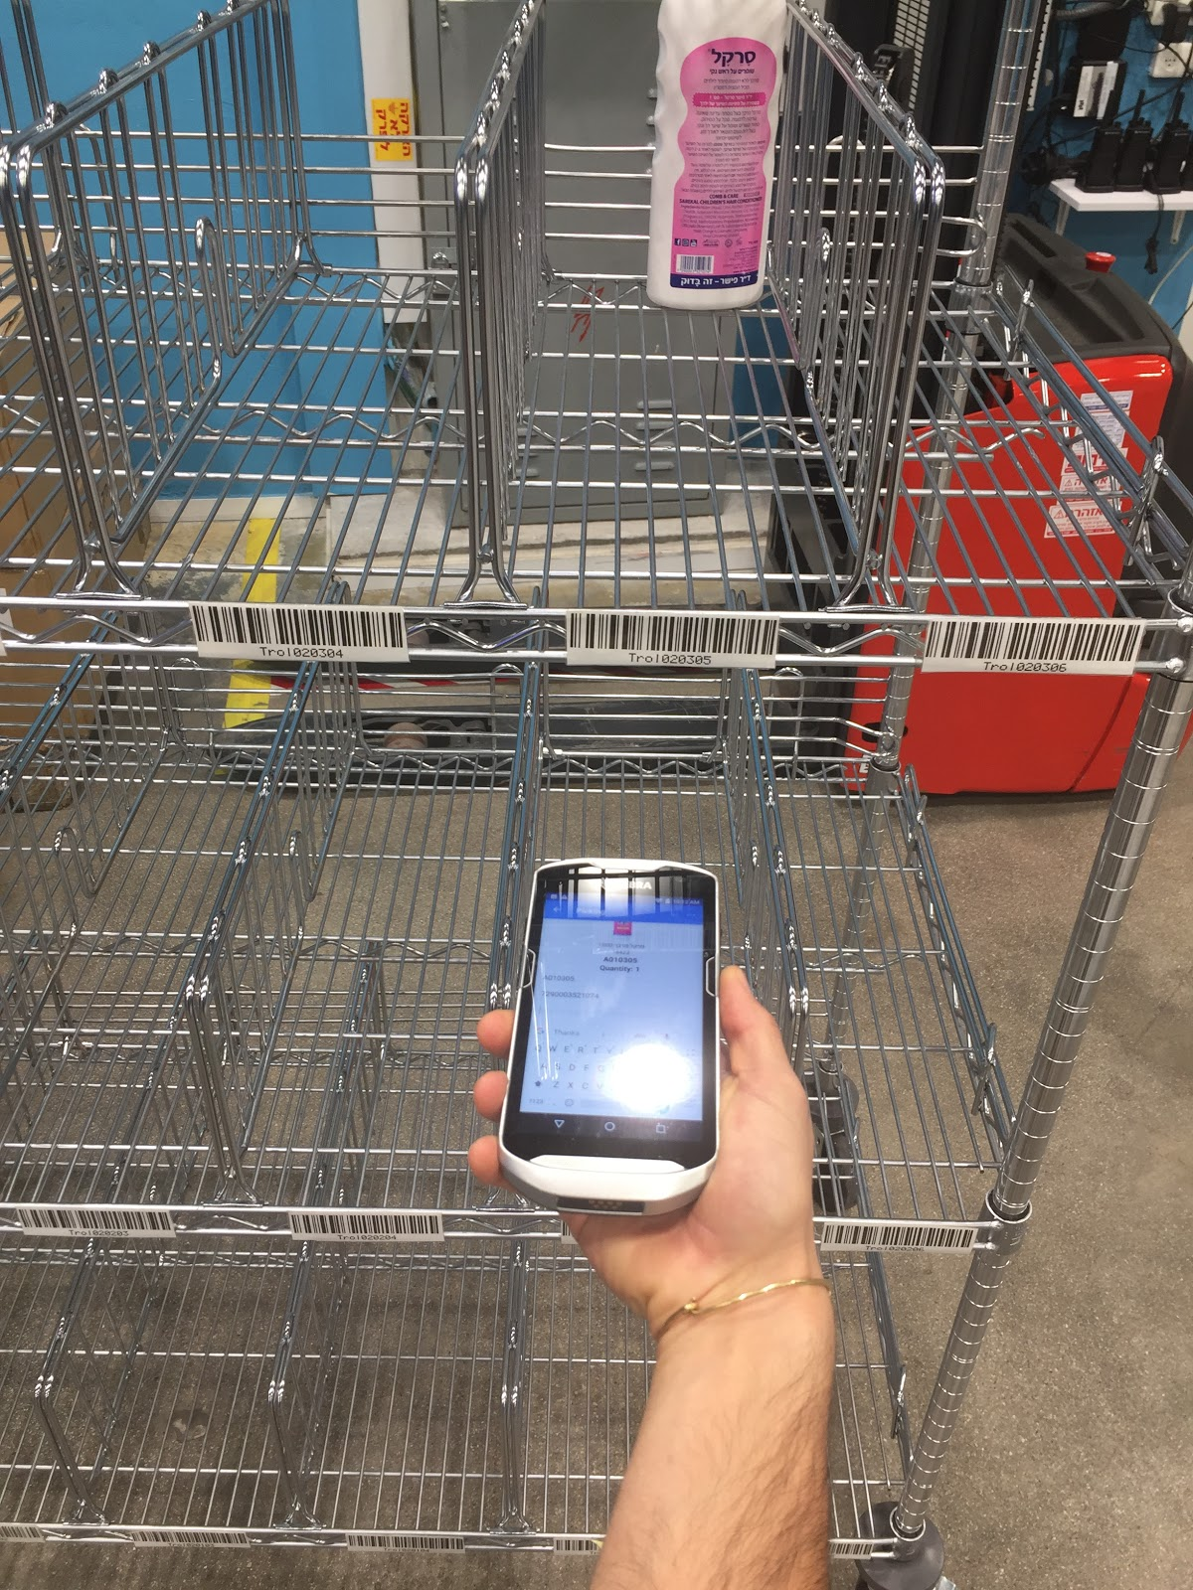
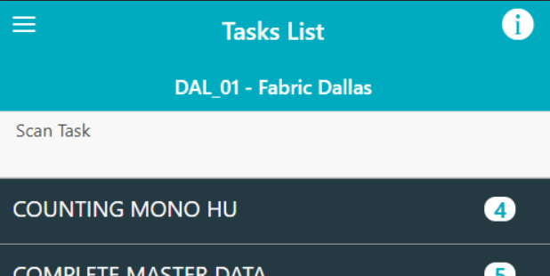
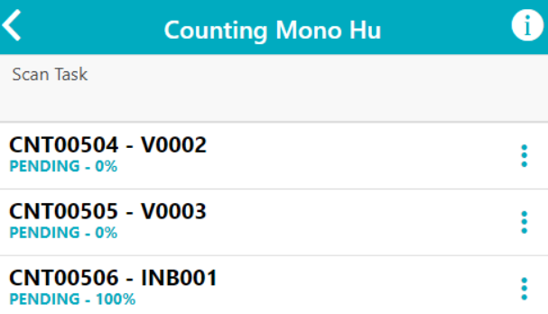
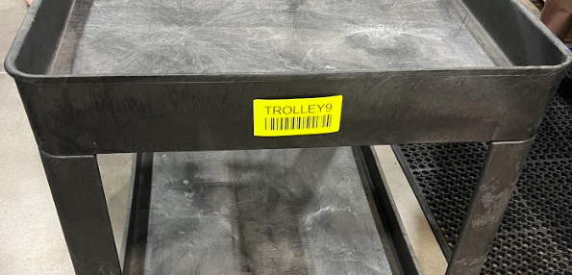
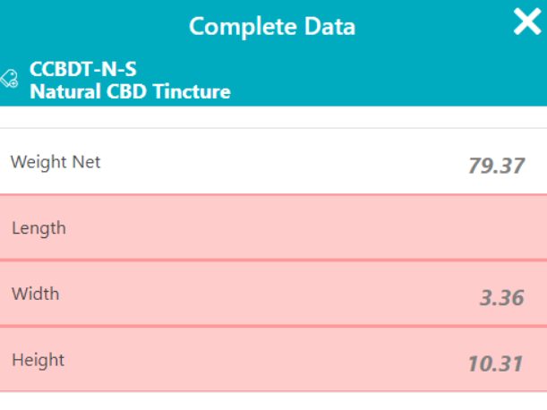
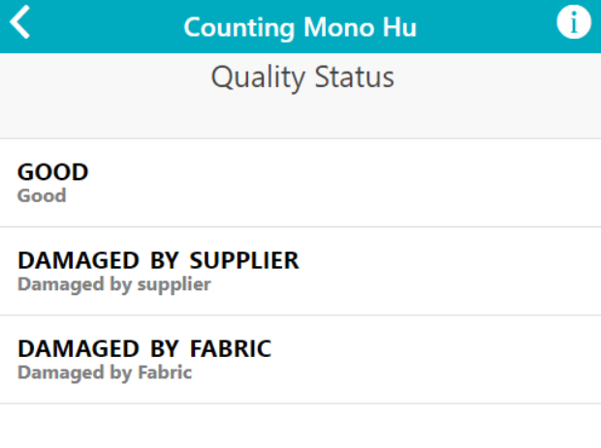
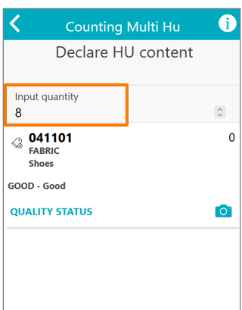
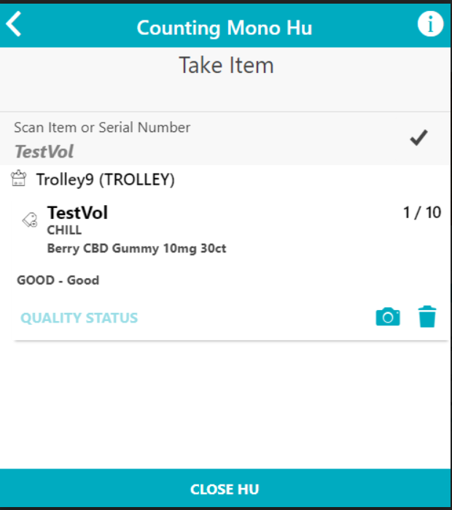

 |  | Receive: Counting Process
ID # | RRC03 | Revision # | 02 | Approved by | D.Morton | Location and Freq.
Facility | US | Revision Date | 5/20/2022 | Date | 6/7/2022 | Receiving Area Inbound Receipts Items
Document Owner | Site Manager | Other PMVs | Receive: Driver Arrives On Site Quality Control Check During Receiving
Happy Flow | Perform receiving tasks → Login to select Count Mono HU → Select task → Scan trolley → Check for damage → Scan item code →Enter required item information → Select quality status → Enter quantity → Place items on trolley → Flatten carton and dispose of waste
Safety Requirements |  | Quality Tips/Definitions
A. Wear cut resistant gloves while manipulating cutter knives and always use proper PPE. |  | A. All product must be visually inspected.
B. If using a pallet jack do not exceed its capacity and do not place feet under pallet jack. |  | B. Contact the Shift Manager about damaged product immediately.
C. Watch your step when walking around manual areas to avoid trips/falls. |  | C. Clean area of visible debris once tasks are complete.
D. Use proper lifting techniques when loading and unloading.
E.
1 | 2 | 3 | 4
Retrieve HHT, make sure HHT is charged and sign in. | Under task list select Count Mono HU. | Select the task to complete. | Scan trolley cart to place items before putaway.
5 | 6 | 7 | 8
2
Check for damaged items. If damaged items are identified, set aside do not add to count. | Scan item and input product dimensions and weight, if required. | Select the Good for quality status of the product. If items are damaged set them aside and notify manager. | Count and enter Quantity Received. Do not count any damaged items in received.
9 | 10 | 11 | 12
Move product to trolley cart. Continue until all products are received. Then select Close HU. Notify Shift Manager once complete. | Once all product has been counted the Manager will verify and close the counting task on the desktop computer. | Once finished, flatten out the carton and put inside cardboard cage. Dispose of any plastic waste appropriately. | Did you make a mistake? Let your shift manager know the item information/barcode that has the mistake.

Slide 12
 |  | Receive: Exceptions, Errors, and Resolutions (Reply)
ID # | RRC04 | Revision # | 02 | Approved by | D.Morton | Location and Freq.
Facility | US | Revision Date | 5/6/2022 | Date | 6/7/2022 | Receiving Area Every inbound receival
Document Owner | Site Manager | Other PMVs | All Receive PMVs
Safety Requirements |  | Quality Tips/Definitions
A. Wear cut resistant gloves while manipulating cutter knives and always use proper PPE. |  | A. All product must be visually inspected.
B. If using a pallet jack do not exceed its capacity and do not place feet under pallet jack. |  | B. Contact the Shift Manager about damaged product immediately.
E. Use proper lifting techniques when loading and unloading. |  | C. Clean area of visible debris once tasks are complete.
F. Always use proper PPE.
Exceptions
1 | 2 | 3 | 4
Exception: Delivery arrives outside of time slot | Exception: No inbound file & buyer does not answer when contacted | Exception: Delivery arrives with obvious oversupply | Exception: Delivery arrives with obvious undersupply
Resolution: Fabric to accept delivery if possible. Option to postpone/reject delivery if necessary. | Resolution: Reject and turn away driver. Accept delivery and leave in staging area until Inbound file received via API. | Resolution: For POs, FM to check correct pallet quantity and clearly mark oversupply pallets. Fabric reports oversupply physical pallets to vendor. | Resolution: Accept delivery and communicate to vendor.
5 | 6
Exception: The BOL is not available in SAP | Exception: No shipping document from driver
Resolution: Fabric to contact vendor to get BOL to proceed with receiving. | Resolution: If pallet can be scanned, scan pallet. If pallet cannot be scanned, escalate to vendor.
Errors
1 | 2 | 3 | 4
Error: Obvious damage was found in the pallet/cage/box | Error: “Invoice X under status new was not found” | Error: Another screen of “Choose supplier” appeared | Error: Another screen of “Scan the Actual invoice barcode” appeared
Resolution: Contact shift manager in order to get permission to reject the delivery or to respond to the damage. | Resolution: Give the invoice to the Shift manager and share the error information. | Resolution: The invoice ID you have entered exists more than once for different suppliers. Choose the supplier provided the items. | Resolution: Scan the Actual invoice ID appears on the physical invoice.

Slide 13
Putaway/Stow

Slide 14
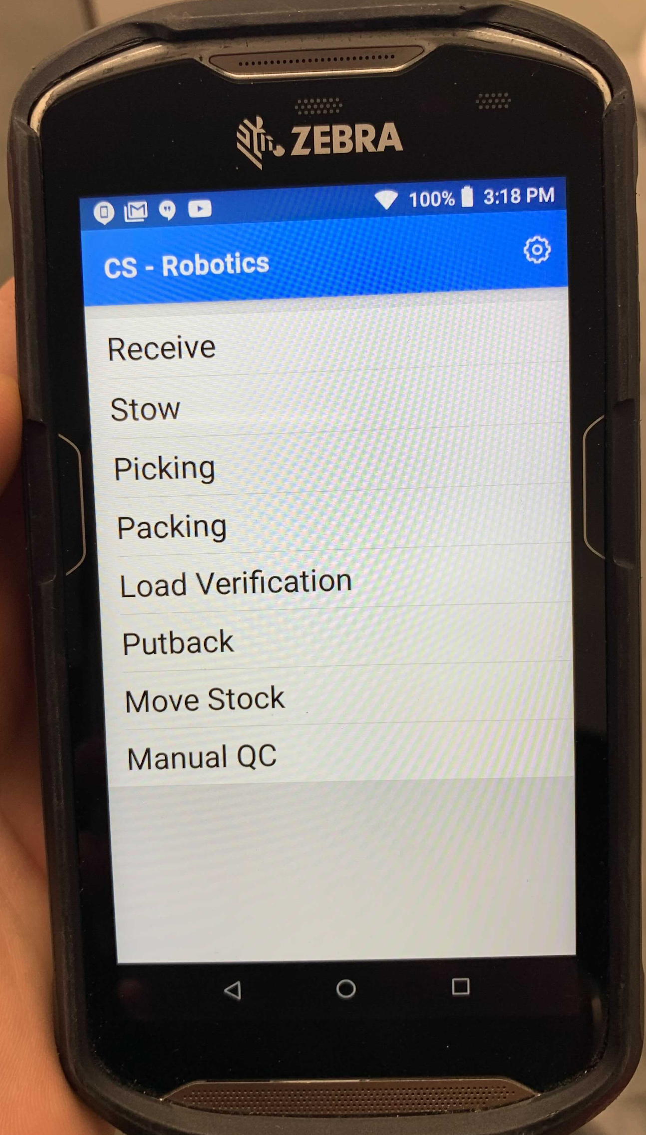
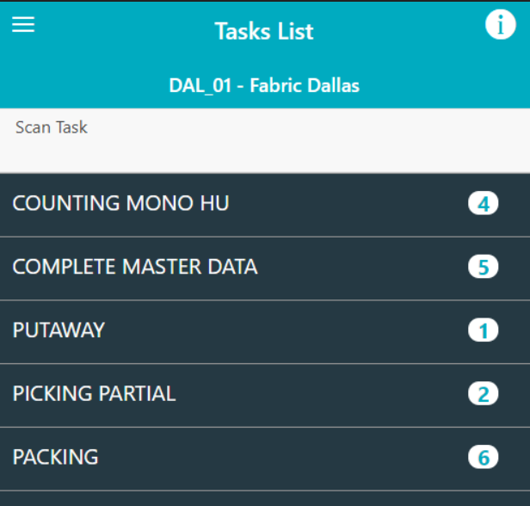
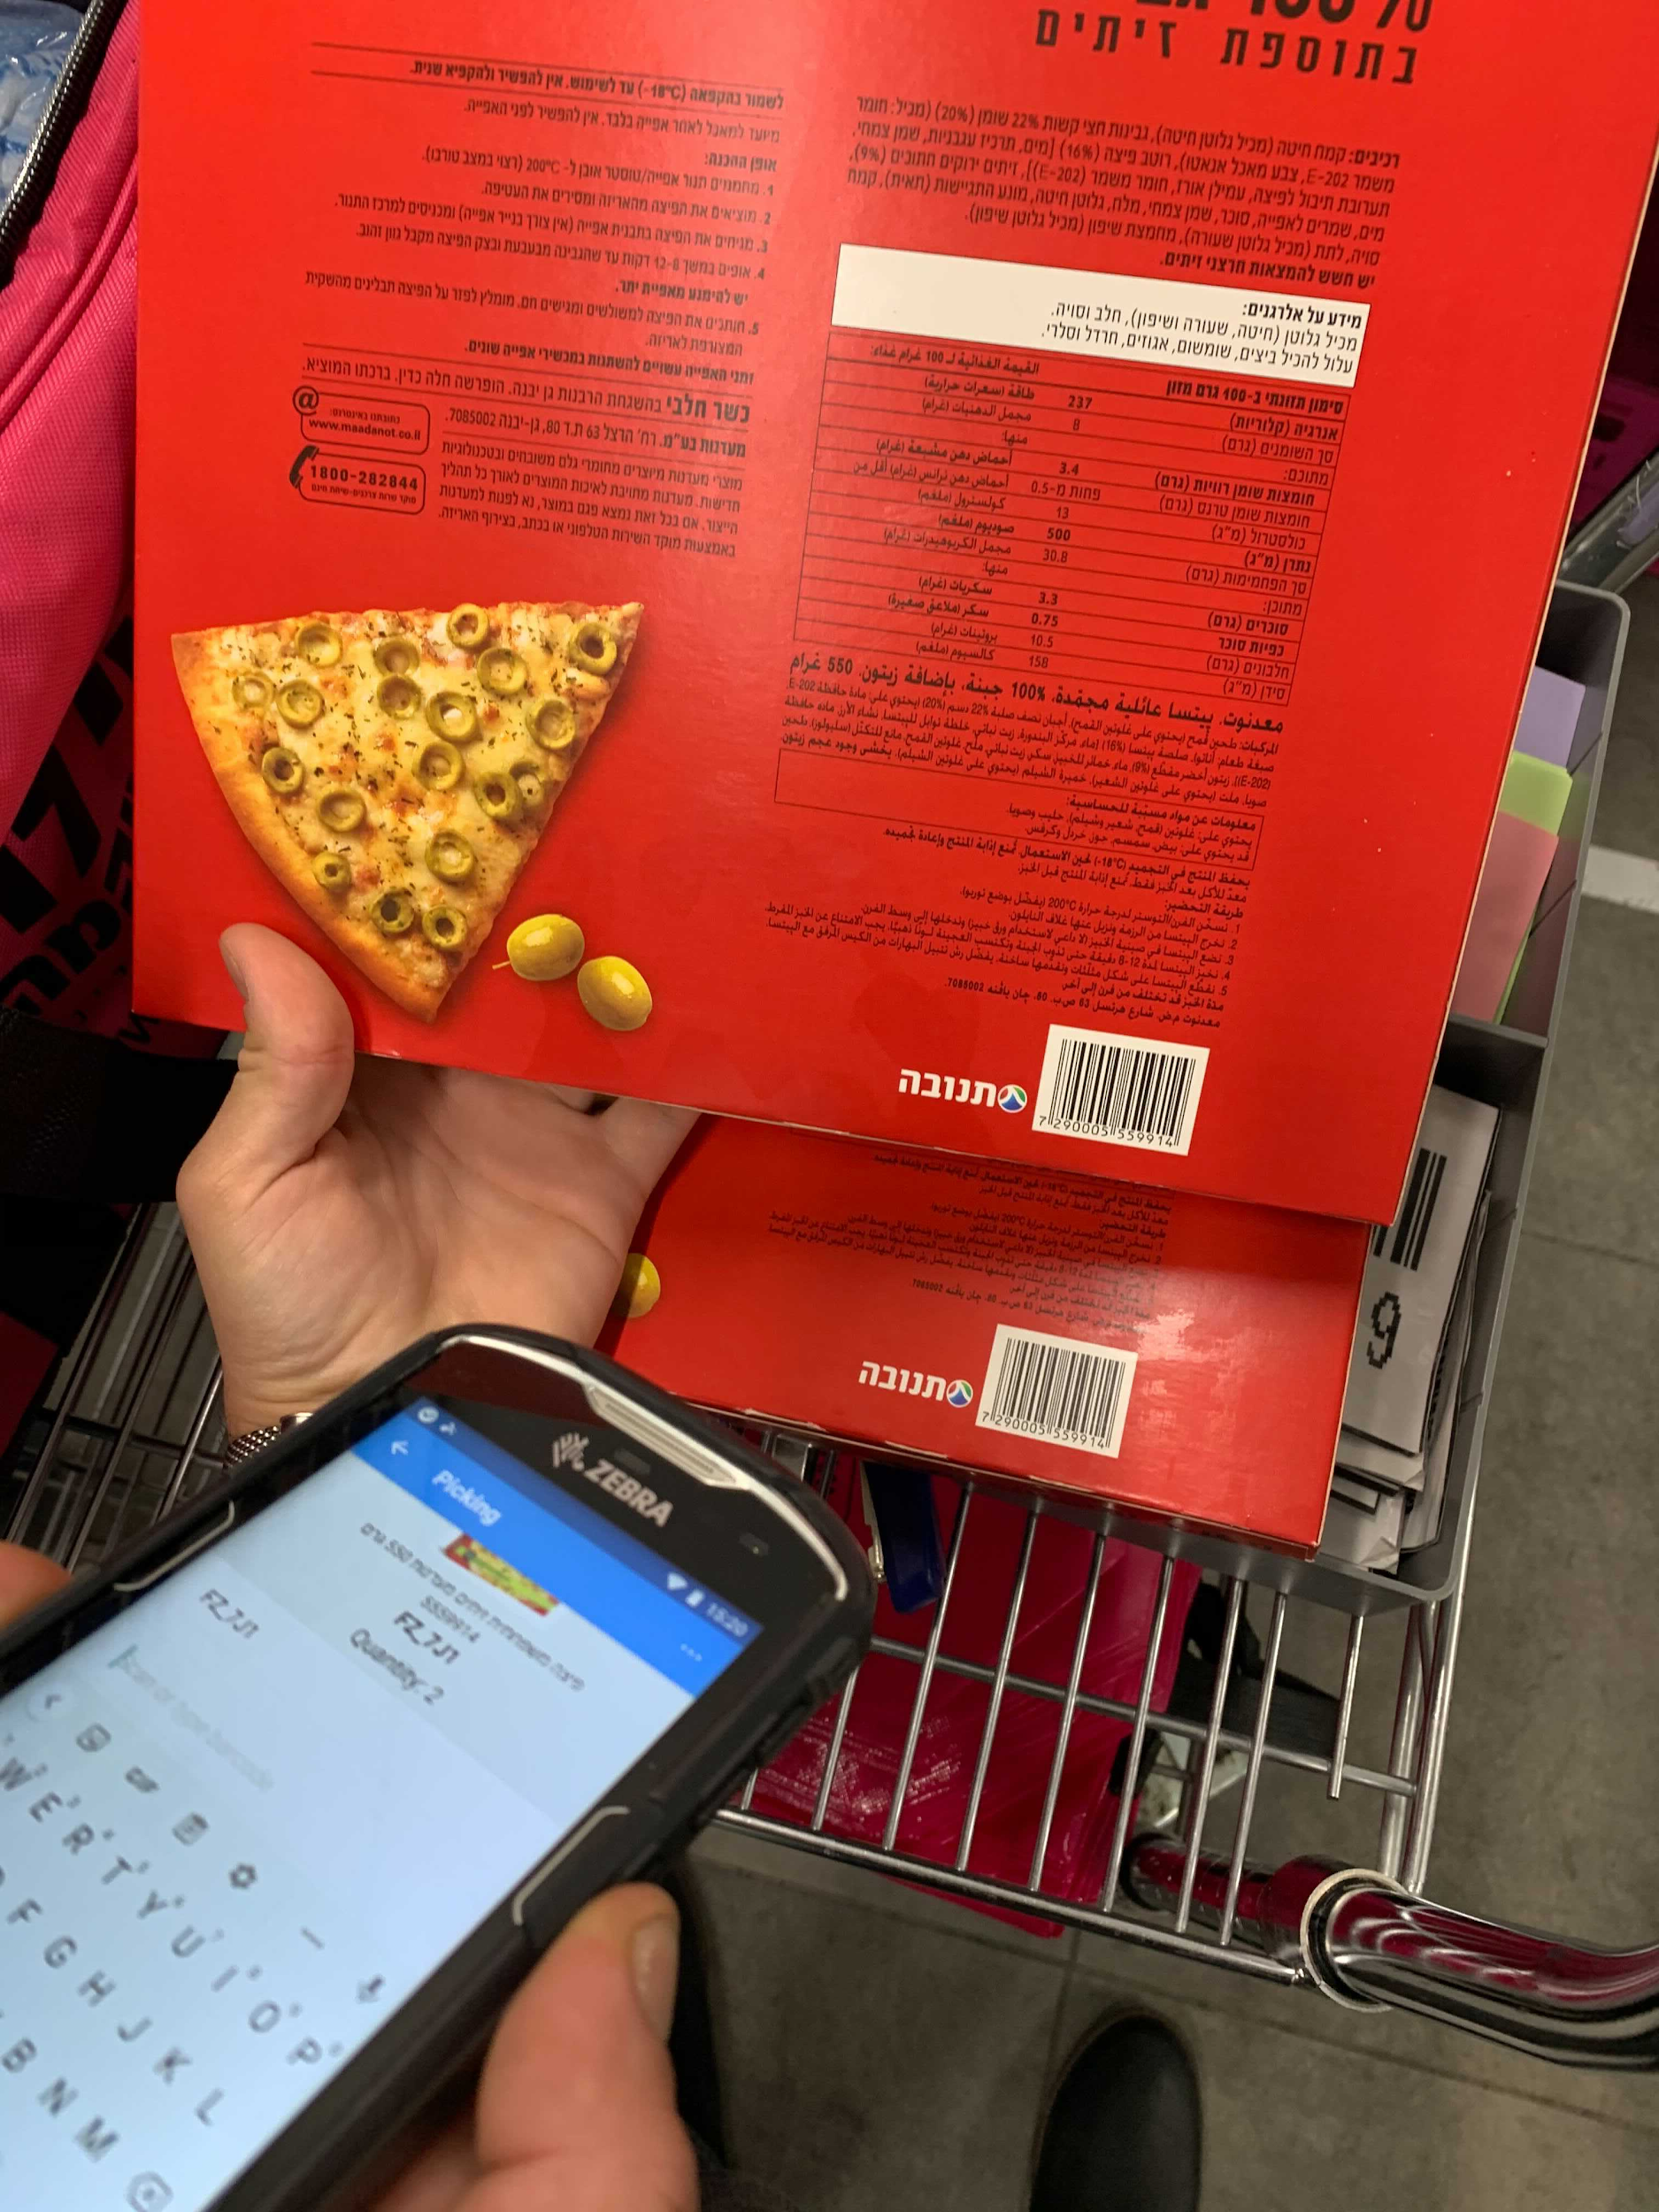
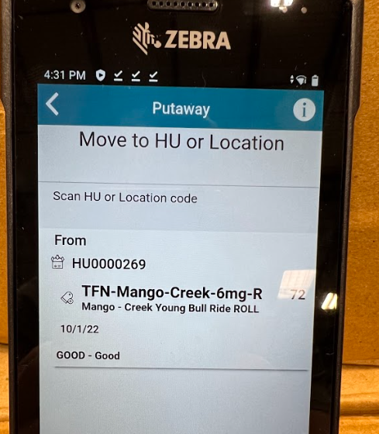
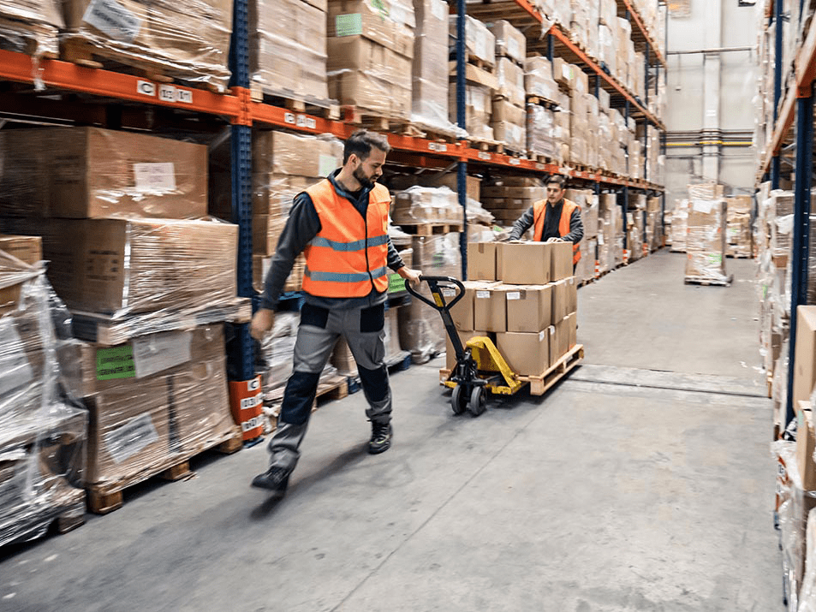
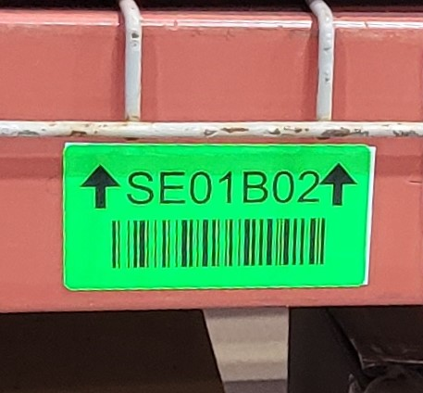
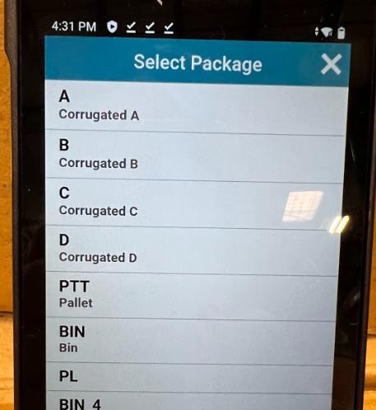

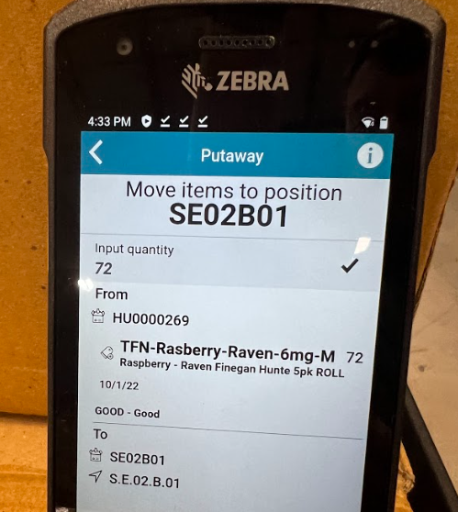
 |  |  | Manual Putaway/Stow
ID # | MPS01 |  | Revision # | 02 | Approved by | D.Morton |  | Location and Freq.
Facility | US |  | Revision Date | 4/28/2022 | Date | 6/7/2022 |  | Manual Stow Areas During Putaway/Stow
Document Owner | Site Manager |  | Other PMVs | Receive: Driver Arrives Onsite Receive: Counting Process
Happy Flow |  | Sign into HHT → Select task → Scan trolley → Scan item → Select location to move item → Move inventory item → Scan location → Select Bin → Check for damage → Scan location → Enter quantity
Safety Requirements |  |  |  |  |  |  | Quality Tips/Definitions
A. Wear cut resistant gloves while manipulating cutter knives and always use proper PPE. |  |  |  |  |  |  | A. Manual areas are not expiry managed. Always use and apply FEFO when manually stowing items.
B. If using a pallet jack, do not exceed its capacity and do not place feet under pallet jack. |  |  |  |  |  |  | B. Food & Chemicals and different allergens cannot be decanted on the same location.
C. Never overfill stow areas. If it is dirty, clean it. |  |  |  |  |  |  | C. Always prefer Stow to Suggested Location if possible - improves the site’s efficiency and density.
D. When possible, stow full cases/pallets of the same item to avoid extra movement of cases/pallets. |  |  |  |  |  |  | D. To avoid leakage, liquid items must be up-right on designated location.
E. If stow location needs to be created, verify pallet condition before moving to avoid spillage/damage of products (wrap pallet if necessary).
F. Use proper lifting techniques when loading and unloading.
1 |  |  |  | 2 |  |  | 3 |  | 4
Verify HHT unit is charged and login into the system. |  |  |  | Select Putaway in the tasks list. |  |  | Scan the trolley cart to open the task. |  | Scan a product and the HHT will suggest a location.
5 |  |  |  | 6 |  |  | 7 |  | 8
If location is full or the HHT does not give a location. The Operator can scan any location that is available. |  |  |  | Take the products to location. |  |  | Scan the bin location where the product will be placed. |  | Select Bin as the package type.
9 |  |  |  | 10 |  |  | 11 |  | 12
Scan the bin location again. |  |  |  | Operator conducts a six sided quality check before confirming quantity to move. If any items are damaged set aside and do not include in count. |  |  | Operator confirms the quantity of the product being placed in bin. The putaway/stow task is complete. |  | Did you make a mistake? Let your shift manager know the item information/ barcode that has the mistake.

Slide 15
 |  | Manual Putaway/Stow: Exceptions and Resolutions
ID # | MSR01 | Revision # | 02 | Approved by | D.Morton | Location and Freq.
Facility | US | Revision Date | 5/5/2022 | Date | 6/7/2022 | Manual Stow Areas During Putaway/Stow
Document Owner | Site Manager | Other PMVs | Manual Putaway/Stow
Safety Requirements |  | Quality Tips/Definitions
A. Wear cut resistant gloves while manipulating cutter knives and always use proper PPE. |  | A. Manual areas are not expiry managed. Always use and apply FEFO when manually stowing items
B. If using a pallet jack, do not exceed its capacity and do not place feet under pallet jack. |  | B. Food & Chemicals and different allergens cannot be decanted on the same location.
C. Never overfill stow areas. If it is dirty, clean it. |  | C. Always prefer Stow to Suggested Location if possible - improves the site’s efficiency and density.
D. When possible, stow full cases/pallets of the same item to avoid extra movement of cases/pallets. |  | D. To avoid leakage, liquid items must be up-right on designated location.
E. If stow location needs to be created, verify pallet condition before moving to avoid spillage/damage of products (wrap pallet if necessary).
F. Use proper lifting techniques when loading and unloading.
1 | 2 | 3 | 4
Exception: No physical pallet Stowing location is available | Exception: Barcode not scannable | Exception: Item does not fit in totes because item is oversized | Exception: SKU not associated to inbound file/catalogue/booklet
Resolution: If there is an occupied physical pallet stowing location with only few items left, free this location by moving these items to another location. If not, stow physical pallet cases in the manual racks. | Resolution: If barcode is readable, manually enter into the HHT. If not readable, Operator to consult with manager on duty. | Resolution: If items are in a box, you can cut the flaps off the box and use it as a tote (bin). | Resolution: Operator to inform manager. Manager to escalate to vendor. Update inbound file/catalogue or return to vendor.
5 | 6 | 7 | 8
Exception: Stow location is dirty | Exception: HHT prompts that a different SKU is stowed in this location (although location is physically empty) | Exception: Damaged product from supplier is received | Exception: Damaged product after received from supplier
Resolution: If possible, manually clean the location. If more severe case, indicate dirty location to SM and stow in another location. | Resolution: Operator performs manual QC process to report location is empty and free. | Resolution: Set aside and inform Shift Manager. | Resolution: Set aside and inform Shift Manager

Slide 16
Inventory Management

Slide 17
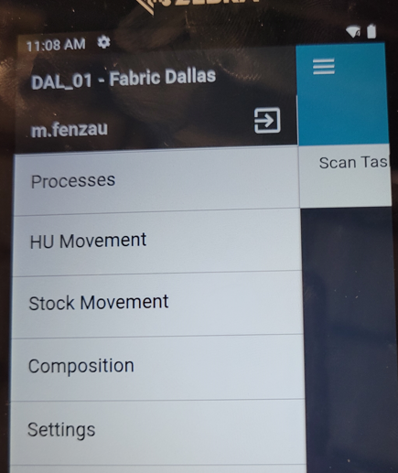
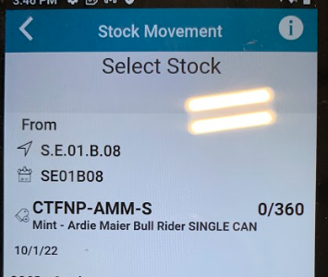
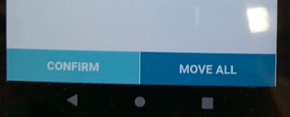
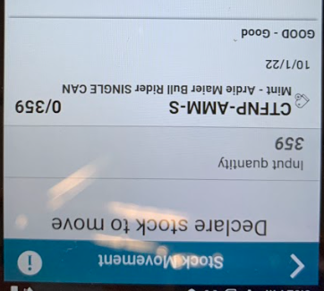
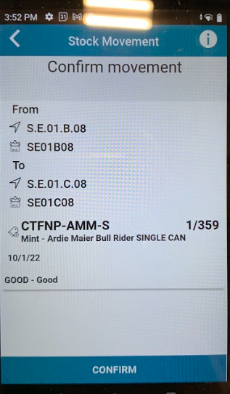
 |  |  | Inventory Management: Stock Movement
ID # | SMM01 |  | Revision # | 02 | Approved by | D.Morton |  | Location and Freq.
Facility | US |  | Revision Date | 5/5/2022 | Date | 6/7/2022 |  | Handling Unit Location Stock Movement
Document Owner | Site Manager |  | Other PMVs | Manual Putaway/Stow
Happy Flow |  | Select Stock Movement → Scan location of inventory → Select the inventory → Enter quantity or select move all → Scan destination → Confirm move → Conduct six-sided quality check → Move inventory
Safety Requirements |  |  |  |  |  |  | Quality Tips/Definitions
A. Wear cut resistant gloves while manipulating cutter knives and always use proper PPE. |  |  |  |  |  |  | A. Manual areas are not expiry managed. Always use and apply FEFO when manually stowing items.
B. If using a pallet jack, do not exceed its capacity and do not place feet under pallet jack. |  |  |  |  |  |  | B. Manual stow areas must be clean before introducing items to the system.
C. Never overfill stow areas. If it is dirty, clean it. |  |  |  |  |  |  | C. Always verify the quality of the product throughout the process flow.
D. Watch your step when walking around manual areas to avoid trips/falls.
E. Use proper lifting techniques when loading and unloading.
1 |  |  |  | 2 |  |  | 3 |  | 4
Verify HHT unit is charged and login into LEA. Go to Stock Movement from the main list. |  |  |  | Scan the Handling Unit (location) where the inventory is located. |  |  | Select the stock to move. Any reserved stock can not be moved. |  | Select Move All to move all available stock or select Confirm to input the quantity to move.
5 |  |  |  | 6 |  |  | 7 |  | 8
Input Quantity to move then select Confirm. |  |  |  | Scan the Destination where the stock will be moved. |  |  | Select Confirm. |  | Operator conducts a six-sided quality check. Place any damage item(s) in designated area and notify Manager.
9 |  |  |  | 10
Operator physically moves stock to new location. |  |  |  | Did you make a mistake? Let your shift manager know the item information/ barcode that has the mistake.

Slide 18
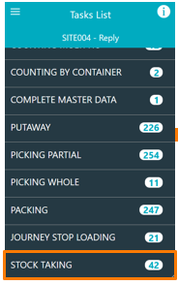
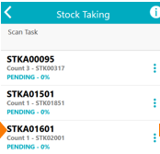
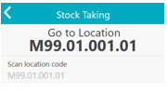



 |  |  | Inventory Management: Stock Taking
ID # | STM01 |  | Revision # | 02 | Approved by | D.Morton |  | Location and Freq.
Facility | US |  | Revision Date | 5/20/2022 | Date | 6/7/2022 |  | Stock Location Stock Taking Movement
Document Owner | Site Manager |  | Other PMVs | Manual Putaway/Stow
Happy Flow |  | Select Stock Taking → Select task → Go to listed location → Scan location → Click skip → Enter expiry date → Enter quantity → Select confirm → Conduct six-sided quality check
Safety Requirements |  |  |  |  |  |  | Quality Tips/Definitions
A. Wear cut resistant gloves while manipulating cutter knives and always use proper PPE. |  |  |  |  |  |  | A. Manual areas are not expiry managed. Always use and apply FEFO when manually stowing items.
B. If using a pallet jack, do not exceed its capacity and do not place feet under pallet jack. |  |  |  |  |  |  | B. Manual stow areas must be clean before introducing items to the system.
C. Never overfill stow areas. If it is dirty, clean it. |  |  |  |  |  |  | C. Always verify the quality of the product throughout the process flow.
D. Watch your step when walking around manual areas to avoid trips/falls.
E. Use proper lifting techniques when loading and unloading.
1 |  |  |  | 2 |  |  | 3 |  | 4
Retrieve HHT and verify HHT unit is charged, login into the system. |  |  |  | Select Stock Taking in the menu. |  |  | Select a task. |  | Go to the listed location under, Go To Location.
5 |  |  |  | 6 |  |  | 7 |  | 8
Scan Location twice. |  |  |  | Scan the item code. |  |  | Count the number of units for the item code. |  | Input the Quantity count and select the blue arrow.
9 |  |  |  | 10 |  |  | 11 |  | 12
Select Confirm to confirm the location. |  |  |  | Conduct a six-sided quality check. If any item(s) are damaged move to designated area and notify Shift Manager. |  |  | Did you make a mistake? Let your shift manager know the item information/ barcode that has the mistake.

Slide 19

 |  | Inventory Management: Exceptions and Resolutions
ID # | RIN01 | Revision # | 02 | Approved by | D.Morton | Location and Freq.
Facility | US | Revision Date | 5/6/2022 | Date | 6/7/2022 | All inventory areas All inventory changes
Document Owner | Site Manager | Other PMVs | All Inventory Management PMVs
Safety Requirements |  | Quality Tips/Definitions
A. Wear cut resistant gloves while manipulating cutter knives and always use proper PPE. |  | A. Always verify the quality of the product throughout the process flow.
B. If using a pallet jack, do not exceed its capacity and do not place feet under pallet jack. |  | B. Manual stow areas must be clean before introducing items to the system.
C. Never overfill stow areas. If it is dirty, clean it. |  | C. Always verify the quality of the product throughout the process flow.
D. Watch your step when walking around manual areas to avoid trips/falls.
E. Use proper lifting techniques when loading and unloading.
During Decant
1 | 2
Exception: Not in Inbound File/Catalog Item | Exception: Damaged by supplier/Not Fresh/Arrived Expired Items
Resolution: Keep in their cases and put aside, with a Not In Inbound File sign & name of Supplier. | Resolution: Put item(s) in the designated area.
After Decant
1 | 2 | 3
Exception: Item damaged or not fresh at Picking/QC at TP | Exception: Physical location within trolley with rejected items is full | Exception: Item is recalled or discontinued
Resolution: Put in an individual, separate physical location within trolley. Weight/count items and report through portal (only for external vendors). | Resolution: Drop off items from the trolley into “Unpickable items” area. Items are logically extracted from the system and message is sent to FD. | Resolution: Create QC task at TP with all recalled/discontinued items. Note that Fabric can block stock until FD instructs on how to dispose the item (trash, RTV).
5

Slide 20
Pick

Slide 21







 |  | Picking By Order
ID # | PBO01 | Revision # | 02 | Approved by | D.Morton | Location and Freq.
Facility | US | Revision Date | 5/20/2022 | Date | 6/7/2022 | Manual Pick Locations During Picking
Document Owner | Site Manager | Other PMVs | Packing a Customer Order
Happy Flow | Open HHT under “Picking partial → Select task → Scan metro cart bin location → Go to and scan pick location → Scan item → Conduct a six-sided quality check → Scan metro cart bin → Input Out as location → Select Exit
Safety Requirements |  | Quality Tips/Definitions
A. Wear cut resistant gloves while manipulating safety knives and use proper PPE. |  | A. Conduct a six-sided visual check of all items in order.
B. If using a pallet jack, do not exceed its capacity and do not place feet under pallet jack. |  | B. Place heavier items in bottom of package with lighter items on top.
C. Do not overfill packages. |  | A. Always ensure enough space is available for items.
D. Use proper lifting techniques when loading and unloading. |  | B. Food & Chemicals cannot be packed into the same package.
C. Watch your step when walking around manual areas to avoid trips/falls. |  | C. To avoid leakage, liquid items must be up-right.
F. Do not place boxes on unstable surfaces.
1 | 2 | 3 | 4
Retrieve HHT and metro cart. Verify HHT unit is charged and log in. Select Picking Partial and select a task. | Scan the metro cart pick bin location for order. | Go to location listed on HHT. | Scan item pick location.
5 | 6 | 7 | 8
2
Scan Item Code with HHT. | HHT will show quantity to take. Operator can enter quantity or select the check mark if quantity is correct. | Operator conducts a six-sided quality check of each item. If item(s) are damaged set off to the side and notify Manager. | Place items into correct pick bin location.
9 | 10 | 11 | 12
Go to next location if more items are listed on order. Continue this process until all picks are complete. | Once all picks are complete, input Out in the location and select Exit. | Picking Operator takes metro cart to pack station staging area. | Did you make a mistake? Let your shift manager know the item information/ barcode that has the mistake.

Slide 22
 |  | Pick: Exceptions and Resolutions
ID # | PKE01 | Revision # | 02 | Approved by | D.Morton | Location and Freq.
Facility | US | Revision Date | 5/6/2022 | Date | 6/7/2022 | Manual Pick Locations During Picking
Document Owner | Site Manager | Other PMVs | Picking By Order Packing a Customer Order
Safety Requirements |  | Quality Tips/Definitions
A. Wear cut resistant gloves while manipulating safety knives and use proper PPE. |  | A. Conduct a six-sided visual check of all items in order.
B. If using a pallet jack, do not exceed its capacity and do not place feet under pallet jack. |  | B. Place heavier items in bottom of package with lighter items on top.
C. Do not overfill packages. |  | A. Always ensure enough space is available for items.
D. Use proper lifting techniques when loading and unloading. |  | B. Food & Chemicals cannot be packed into the same package.
C. Watch your step when walking around manual areas to avoid trips/falls. |  | C. To avoid leakage, liquid items must be up-right.
F. Do not place boxes on unstable surfaces.
1 | 2 | 3 | 4
Exception: Outbound staging location dirty or damaged | Exception: Wrong SKU in stock bin location | Exception: Damaged or expired/expired marketing items in stock bin location | Exception: Insufficient stock quantity in manual bin location
Resolution: Clean, if possible, otherwise use a different outbound staging location and inform SM. | Resolution: Perform manual QC process to confirm actual contents of manual bin location; continue picking from new bin as instructed by HHT | Resolution: Pick alternative undamaged/unexpired items where possible. Otherwise move damaged stock to Damaged rack and/or escalate to SM if required. | Resolution: Pick available stock and then report exception via on-screen menu. Continue picking from next location as instructed by HHT. If bin is empty at beginning of pick, report stock exception ‘No items in bin’.
5 | 6 | 7
Exception: Barcode cannot be scanned | Exception: Barcode is missing (or cannot be read or scanned) | Exception: Bin is empty
Resolution: Type in barcode manually via on-screen numeric keypad. | Resolution: Scan a different item of the same SKU or escalate to SM if required. | Resolution: Make sure you are scanning the correct bin.

Slide 23
 |  | Pick: Risks and Resolutions
ID # | PRR01 | Revision # | 02 | Approved by | D.Morton | Location and Freq.
Facility | US | Revision Date | 5/6/2022 | Date | 6/7/2022 | Manual Picking Locations During Picking
Document Owner | Site Manager | Other PMVs | All Picking PMVs
Safety Requirements |  | Quality Tips/Definitions
A. Wear cut resistant gloves while manipulating safety knives and use proper PPE. |  | A. Conduct a six-sided visual check of all items in order.
B. If using a pallet jack, do not exceed its capacity and do not place feet under pallet jack. |  | B. Place heavier items in bottom of package with lighter items on top.
C. Do not overfill packages. |  | A. Always ensure enough space is available for items.
D. Use proper lifting techniques when loading and unloading. |  | B. Food & Chemicals cannot be packed into the same package.
C. Watch your step when walking around manual areas to avoid trips/falls. |  | C. To avoid leakage, liquid items must be up-right.
F. Do not place boxes on unstable surfaces.
1 | 2 | 3 | 4
Risk: Picker picks from wrong source manual bin location | Risk: Picker picks wrong SKU | Risk: Picker picks incorrect quantity | Risk: Picker does not package correctly
Resolution: On-screen indication on HHT of correct manual stock bin provides clear direction to operator, and system validates by scanning. If wrong bin is scanned, HHT displays error message. | Resolution: System validates correct SKU by scanning, in addition to on-screen SKU image providing visual indication. | Resolution: HHT indicates quantity, and the operator is required to confirm quantity. | Resolution: On-screen instructions and operator training.
5 | 6 | 7 | 8
Risk: Packaging materials depleted | Risk: Weighing scale station malfunction | Risk: Depletion of labels on weighing scale station, unable to scan weight | Risk: Depletion of HHT batteries
Resolution: SM ensures full stock of packaging materials at beginning of shift. Dual storage ensures continuity of operations during mid-operation replenishment by SM. | Resolution: Escalate to SM. | Resolution: Shift manager to ensure sufficient labels loaded at shift start. | Resolution: Use a different HHT. Ensure HHTs are fully charged before use and placed on charge at the end of the shift. The chargers are located on the manager’s station.

Slide 24
Pack

Slide 25









 |  | Split Packaging For Customer Order: Weight Limited to One Pound
ID # | WOP01 | Revision # | 02 | Approved by |  | Location and Freq.
Facility | DAL01 | Revision Date | 5/19/2022 | Date |  | Pack Station Every outbound order
Document Owner | Site Manager | Other PMVs
Happy Flow | Sign into HHT → Select tasks list → Scan metro cart bin → Conduct a six-sided quality check → Select package type → Select confirm parcel → Ensure enough of each item is in order → Pack order → Place shipping label on package → Place package on carrier pallet
Safety Requirements |  | Quality Tips/Definitions
A. Wear cut resistant gloves while manipulating safety knives and use proper PPE |  | A. Conduct a six-sided visual check of all items in order
B. If using a pallet jack, do not place feet under pallet jack |  | B. Place heavier items in bottom of package with lighter items on top
C. Do not overfill totes and distribute weight across the tote
D. Use proper lifting techniques when loading and unloading
1 | 2 | 3 | 4
At pack station, the Packing Operator will ensure that the HHT is charged and sign in. Select Packing from the menu. | Select an order to pack. Scan the metro cart bin that is staging that customer order. | Perform a six-sided visual quality check of each item. If damaged repick the item(s), replace damaged items and inform Shift Manager. | Place all units from a single order on the scale. If the weight of the total order is under one pound, continue to step six.
5 | 6 | 7 | 8
If the total order weight exceeds one pound, you will need to split the order. Remove items from the scale until the weight is under one pound. | Scan the items that remain on the scale. Again, this weight cannot exceed one pound. | Select a package type to ship the item(s). Select Confirm Parcel. Once complete select Confirm. | Place products in bubble mailer and seal the package. Go to label printer and retrieve shipping label.
9 | 10 | 11 | 12
Place shipping label on bubble mailer. | Place bubble mailer on outbound pallet next to pack station. | If there are more items in the order, you will return to step six and repeat the process until all items are scanned and associated with a parcel. | Did you make a mistake? Let your shift manager know the item information/ barcode that has the mistake.

Slide 26
 |  | Pack: Exceptions and Resolutions
ID # | PCE01 | Revision # | 2 | Approved by | D.Morton | Location and Freq.
Facility | US | Revision Date | 5/6/2022 | Date | 6/7/2022 | Pack Stations Any Packing Exceptions
Document Owner | Site Manager | Other PMVs | All Packing PMVs
Safety Requirements |  | Quality Tips/Definitions
A. Wear cut resistant gloves while manipulating safety knives and use proper PPE. |  | A. Conduct a six-sided visual check of all items in order.
B. If using a pallet jack, do not exceed its capacity and do not place feet under pallet jack. |  | B. Place heavier items in bottom of package with lighter items on top.
C. Do not overfill packages. |  | A. Always ensure enough space is available for items.
D. Use proper lifting techniques when loading and unloading. |  | B. Food & Chemicals cannot be packed into the same package.
C. Watch your step when walking around manual areas to avoid trips/falls. |  | C. To avoid leakage, liquid items must be up-right.
1
Exception: Damaged items
Resolution: Determine if there is available stock to replace damaged item or locate a substitute. Replace damaged items if possible. If not, report issue to SM.
9 | 10 | 11 | 12

Slide 27
Shipping/Dispatch

Slide 28








 |  | Journey Creation
ID # | RJC01 | Revision # | 02 | Approved by | D.Morton | Location and Freq.
Facility | US | Revision Date | 5/6/2022 | Date | 6/7/2022 | Outbound Every Outbound Order
Document Owner | Site Manager | Other PMVs | Packing a Customer Order Start Journey
Happy Flow | Select Interplant → Select Resources → Select Journey Template → Select Template → Select Create Journey → Input date and time → Select Execute
Safety Requirements |  | Quality Tips/Definitions
A. Wear cut resistant gloves while manipulating safety knives and always use proper PPE. |  | A. All product must be visually inspected.
B. If using a pallet jack do not exceed its capacity and do not place feet under pallet jack. |  | B. If items are damaged contact the Shift Manager immediately.
C. Watch your step when walking around manual areas to avoid trips/falls. |  | C. Clean area of visible debris once tasks are complete.
D. Use proper lifting techniques when loading and unloading. |  | D. Verify supplies for dispatch are available for completing orders to avoid delays.
1 | 2 | 3 | 4
Go to desktop computer and sign into LEA platform. | Select Interplant from the menu. | Select Resources. | Select Journey Template.
5 | 6 | 7 | 8
Select USPS template. | Click on Create Journey. | In the Journey Template, enter the departure date and time in the Date box. | Select Execute, the journey is now created.
9 | 10
If completed properly a message saying Action executed properly will appear. | Did you make a mistake? Let your shift manager know and include the item information/ barcode.

Slide 29




 |  | Start Journey
ID # | SJ01 | Revision # | 02 | Approved by | D.Morton | Location and Freq.
Facility | US | Revision Date | 5/6/2022 | Date | 6/7/2022 | Outbound Every Outbound Order
Document Owner | Site Manager | Other PMVs | Journey Creation Journey Preparation
Happy Flow | Select Interplant → Select Resources → Select Journey → Select the Journey created → Select Actions drop-down menu → Select Start Journey
Safety Requirements |  | Quality Tips/Definitions
A. Wear cut resistant gloves while manipulating safety knives and always use proper PPE. |  | A. All product must be visually inspected.
B. If using a pallet jack do not exceed its capacity and do not place feet under pallet jack. |  | B. If items are damaged contact the Shift Manager immediately.
C. Watch your step when walking around manual areas to avoid trips/falls. |  | C. Clean area of visible debris once tasks are complete.
D. Use proper lifting techniques when loading and unloading. |  | D. Verify supplies for dispatch are available for completing orders to avoid delays.
1 | 2 | 3 | 4
Go to desktop computer and sign into LEA platform. | Select Interplant from the menu | Select Resources | Select Journey
5 | 6 | 7 | 8
Select the journey that was created. | Click on the Actions drop-down menu. | Select Start Journey | Did you make a mistake? Let your shift manager know and include the item information/ barcode.

Slide 30





 |  | Journey Preparation
ID # | JP01 | Revision # | 02 | Approved by | D.Morton | Location and Freq.
Facility | US | Revision Date | 5/6/2022 | Date | 6/7/2022 | Outbound Every Outbound Order
Document Owner | Site Manager | Other PMVs | Start Journey Journey Loading
Happy Flow | Select Interplant → Select Operations → Select Journey Preparations (Parcel) → Select the Journey created → Select parcel(s) to add → Drag and drop to Journey →
Safety Requirements |  | Quality Tips/Definitions
A. Wear cut resistant gloves while manipulating safety knives and always use proper PPE. |  | A. All product must be visually inspected.
B. If using a pallet jack do not exceed its capacity and do not place feet under pallet jack. |  | B. If items are damaged contact the Shift Manager immediately.
C. Watch your step when walking around manual areas to avoid trips/falls. |  | C. Clean area of visible debris once tasks are complete.
D. Use proper lifting techniques when loading and unloading. |  | D. Verify supplies for dispatch are available for completing orders to avoid delays.
1 | 2 | 3 | 4
Go to desktop computer and sign into LEA platform. | Select Interplant from the menu. | Select Operations. | Select Journey Preparations (Parcel).
5 | 6 | 7 | 8
The screen shows all parcels ready to ship and journeys that have been created. | Select the parcel or hold Ctrl to select multiple parcels. | Drag and drop the parcel(s) to the Journey at the right of the screen. | Did you make a mistake? Let your shift manager know and include the item information.

Slide 31



 |  | Remove Parcel From Journey
ID # | RPJ01 | Revision # | 02 | Approved by | D.Morton | Location and Freq.
Facility | US | Revision Date | 5/9/2022 | Date | 6/7/2022 | Outbound Any Parcel(s) that need removed
Document Owner | Site Manager | Other PMVs | Start Journey Journey Loading
Happy Flow | Select Interplant → Select Operations → Select Journey Preparations (Parcel) → Select the Journey created → Select Units to Pick Up → Select the parcel(s) to be removed → Select Delete
Safety Requirements |  | Quality Tips/Definitions
A. Wear cut resistant gloves while manipulating safety knives and always use proper PPE. |  | A. All product must be visually inspected.
B. If using a pallet jack do not exceed its capacity and do not place feet under pallet jack. |  | B. If items are damaged contact the Shift Manager immediately.
C. Watch your step when walking around manual areas to avoid trips/falls. |  | C. Clean area of visible debris once tasks are complete.
D. Use proper lifting techniques when loading and unloading. |  | D. Verify supplies for dispatch are available for completing orders to avoid delays.
1 | 2 | 3 | 4
Go to desktop computer and sign into LEA platform. | Select Interplant from the menu. | Select Operations. | Select Journey Preparations (Parcel).
5 | 6 | 7 | 8
Select the journey that contains the parcels ready for shipment. | Select Units to Pick Up. | Select the parcel(s) that need removed from the Journey. | Select Delete at the top of the screen.
9
Did you make a mistake? Let your shift manager know and include the item information/ barcode.

Slide 32





 |  | Journey Stop Loading
ID # | RJS01 | Revision # | 02 | Approved by | D.Morton | Location and Freq.
Facility | US | Revision Date | 5/9/2022 | Date | 6/7/2022 | Outbound Every Outbound Order
Document Owner | Site Manager | Other PMVs | Journey Preparation Load Ready for Shipping/Dispatch
Happy Flow | Select Interplant → Select Tasks → Select Journey Stop Loading → Select the Journey → Select Actions → Select Start Task
Safety Requirements |  | Quality Tips/Definitions
A. Wear cut resistant gloves while manipulating safety knives and always use proper PPE. |  | A. All product must be visually inspected.
B. If using a pallet jack do not exceed its capacity and do not place feet under pallet jack. |  | B. If items are damaged contact the Shift Manager immediately.
C. Watch your step when walking around manual areas to avoid trips/falls. |  | C. Clean area of visible debris once tasks are complete.
D. Use proper lifting techniques when loading and unloading. |  | D. Verify supplies for dispatch are available for completing orders to avoid delays.
1 | 2 | 3 | 4
Go to desktop computer and sign into LEA platform. | Select Interplant from the menu. | Select Tasks. | Select Journey Stop Loading.
5 | 6 | 7 | 8
Select the journey to complete, these will show a status of To Do. | Select Actions drop-down menu. | Select Start Task. | If completed properly a message saying Action executed properly will appear.
9
Did you make a mistake? Let your shift manager know and include the item information/ barcode.

Slide 33




 |  | Load Ready For Shipping/Dispatch
ID # | LRS01 | Revision # | 02 | Approved by | D.Morton | Location and Freq.
Facility | US | Revision Date | 5/9/2022 | Date | 6/7/2022 | Outbound Every Outbound Order
Document Owner | Site Manager | Other PMVs | Journey Loading Journey Closure
Happy Flow | Greet Driver → Follow TDR procedures → Sign into LEA on desktop computer → Select Interplant → Select Resources → Select Site Freight → Select the Journey → Select Actions → Select load all units → Message will appear if correctly completed→ Driver may now load the parcels
Safety Requirements |  | Quality Tips/Definitions
A. Wear cut resistant gloves while manipulating safety knives and always use proper PPE. |  | A. All product must be visually inspected.
B. If using a pallet jack do not exceed its capacity and do not place feet under pallet jack. |  | B. If items are damaged contact the Shift Manager immediately.
C. Watch your step when walking around manual areas to avoid trips/falls. |  | C. Clean area of visible debris once tasks are complete.
D. Use proper lifting techniques when loading and unloading. |  | D. Verify supplies for dispatch are available for completing orders to avoid delays.
1 | 2 | 3 | 4
Parcel Driver arrives on site. Inform the Driver what dock to use and where the parcel(s) are located. | Ensure all TDR procedures are followed during trailer docking. | Go to desktop computer and sign into LEA platform. | Select Interplant from the menu.
5 | 6 | 7 | 8
Select Task. | Select Journey Stop Loading. | Select the Journey task for the Parcel Driver. | Select Actions drop-down menu.
9 | 10 | 11 | 12
Select Load All Units, the task is now complete. | If completed properly a message saying Action executed properly will appear. | The Parcel Driver may now load the parcel(s). | Did you make a mistake? Let your shift manager know and include the item information/ barcode.

Slide 34





 |  | Journey Closure
ID # | JCL01 | Revision # | 02 | Approved by | D.Morton | Location and Freq.
Facility | US | Revision Date | 5/20/2022 | Date | 6/7/2022 | Outbound Every Outbound Order
Document Owner | Site Manager | Other PMVs | Load Ready for Shipping/Dispatch Trailer Dock Release: Inbound or Outbound Delivery
Happy Flow | Select Interplant → Select Resources → Select Site Freight → Select Journey → Select Actions → Select Departure → Follow TDR during departure → Driver may now leave dock
Safety Requirements |  | Quality Tips/Definitions
A. Wear cut resistant gloves while manipulating safety knives and always use proper PPE. |  | A. All product must be visually inspected.
B. If using a pallet jack do not exceed its capacity and do not place feet under pallet jack. |  | B. If items are damaged contact the Shift Manager immediately.
C. Watch your step when walking around manual areas to avoid trips/falls. |  | C. Clean area of visible debris once tasks are complete.
D. Use proper lifting techniques when loading and unloading. |  | D. Verify supplies for dispatch are available for completing orders to avoid delays.
1 | 2 | 3 | 4
Go to desktop computer and sign into LEA platform. | Select Interplant from the menu. | Select Resources. | Select Site Freight.
5 | 6 | 7 | 8
Select the journey that is ready for departure. | Select Actions drop-down menu. | Select Departure, then Execute. | Verify that all TDR procedures are followed before Driver departs.
9 | 10 | 11 | 12
Return any equipment used during loading. | Did you make a mistake? Let your shift manager know and include the item information/ barcode.

Slide 35
 |  | Shipping/Dispatch: Exceptions, Errors, and Resolutions
ID # | SDE01 | Revision # | 02 | Approved by | D.Morton | Location and Freq.
Facility | US | Revision Date | 5/9/2022 | Date | 6/7/2022 | Outbound During Shipping/Dispatching
Owner | Site Manager | Other PMVs | All Shipping/Dispatch PMVs
Safety Requirements |  | Quality Tips/Definitions
A. Wear cut resistant gloves while manipulating safety knives and always use proper PPE. |  | A. All product must be visually inspected.
B. If using a pallet jack do not exceed its capacity and do not place feet under pallet jack. |  | B. If items are damaged contact the Shift Manager immediately.
C. Watch your step when walking around manual areas to avoid trips/falls. |  | C. Clean area of visible debris once tasks are complete.
D. Use proper lifting techniques when loading and unloading. |  | D. Verify supplies for dispatch are available for completing orders to avoid delays.
1 | 2 | 3
Exception: Damaged item at dispatch | Exception: Order tote arrives at Terminal with very few items | Exception: Audit exception - e.g., missing item/tote discovered
Resolution: Report to Shift Manager to arrange repick of damaged item and inform FM to alert risk to flow. | Resolution: Merge contents into another order tote in order to compact the number of totes and increase outbound shipping density. – Refer to Dispatch Consolidation Merge (DMG01). | Resolution: Report to Shift Manager to arrange repick of missing item and inform FM to alert risk to flow; continue with packing & staging of rest of trip whilst exception is resolved.
Error Popups and Resolutions
1 | 2 | 3 | 4
Error: Order is not ready for packing | Error: Order is set for Putback | Error: The traffic light is red | Error: Waiting for totes for more than two minutes
Resolution: There are still order totes on its way to the Terminal from the shelving units. Wait for upcoming totes and verify all order totes are ready for the trip. | Resolution: The order has been canceled and it is now designated for Putback. Place the order in the “Putback Area.” | Resolution: Press the green button again (repeat twice), it does not resolve contact Shift manager. | Resolution: Notify the shift manager while you specify the TM you are working on and the elevator shaft side.
5
Error: The tote has not come up the shaft
Resolution: Notify the shift manager while you specify the TM you are working on and the elevator shaft side.

Slide 36
 |  | Shipping/Dispatch: Risks and Resolutions
ID # | SDR01 | Revision # | 02 | Approved by | D.Morton | Location and Freq.
Facility | US | Revision Date | 5/9/2022 | Date | 6/7/2022 | Outbound During Shipping/Dispatching
Owner | Site Manager | Other PMVs | All Shipping/Dispatch PMVs
Safety Requirements |  | Quality Tips/Definitions
A. Wear cut resistant gloves while manipulating safety knives and always use proper PPE. |  | A. All product must be visually inspected.
B. If using a pallet jack do not exceed its capacity and do not place feet under pallet jack. |  | B. If items are damaged contact the Shift Manager immediately.
C. Watch your step when walking around manual areas to avoid trips/falls. |  | C. Clean area of visible debris once tasks are complete.
D. Use proper lifting techniques when loading and unloading. |  | D. Verify supplies for dispatch are available for completing orders to avoid delays.
1 | 2 | 3 | 4
Risk: Inaccurate staging | Risk: Terminal malfunction during dispatch | Risk: Label printer malfunction | Risk: Depletion of labels
Resolution: Clear designation of shipping lane and load verification to ensure all order totes are in the correct shipping lane. | Resolution: Use second terminal for dispatching orders, communication with vendor about possible delay, escalation procedure to repair terminal. | Resolution: Use spare label printer, escalation procedure to repair | Resolution: SM to ensure periodically that label printer has sufficient labels

Slide 37
Quality Control

Slide 38


 |  | Quality Control Check During Inbound Deliveries
ID # | QCI01 | Revision # | 02 | Approved by | D.Morton | Location and Freq.
Facility | US | Revision Date | 5/6/2022 | Date | 6/7/2022 | Inbound Every Inbound Deliveries
Document Owner | Site Manager | Other PMVs | Trailer Dock Release: Inbound or Outbound Deliveries Receive: Driver Arrives Onsite
Happy Flow | Delivery Driver unloads product → Delivery Driver places product in Inbound Staging Area → Receiving Operator does a visual quality check walk around → Check for damaged pallet(s) and product(s) → If damage is noticed, contact Shift Manager
Safety Requirements |  | Quality Tips/Definitions
A. Wear cut resistant gloves while manipulating safety knives and always use proper PPE. |  | A. All product must be visually inspected.
B. If using a pallet jack do not exceed its capacity and do not place feet under pallet jack. |  | B. If items are damaged contact the Shift Manager immediately.
C. Watch your step when walking around manual areas to avoid trips/falls. |  | C. Clean area of visible debris once tasks are complete.
D. Use proper lifting techniques when loading and unloading.
1 | 2 | 3 | 4
Delivery Driver unloads products from trailer. | Delivery Driver places product in Inbound Staging Area. | Receiving Operator conducts a complete walk around to check for damage to the pallet(s). | Receiving Operator conducts a quality check of carton(s).
5 | 6
If visual damage is noticed, contact the Shift Supervisor right away. | Did you make a mistake? Let your shift manager know and include the item information/ barcode.

Slide 39





 |  | Quality Control Check During Receiving
ID # | QCR01 | Revision # | 02 | Approved by | D.Morton | Location and Freq.
Facility | US | Revision Date | 5/6/2022 | Date | 6/7/2022 | Inbound Every Inbound Deliveries
Document Owner | Site Manager | Other PMVs | Receive: Driver Arrives Onsite
Happy Flow | Move product from Inbound to Receiving → Conduct a visual check → Retrieve HHT and sign in → Scan item code → Select Quality Status → Select Good → Input any required information → Select confirm → Input the quantity
Safety Requirements |  | Quality Tips/Definitions
A. Wear cut resistant gloves while manipulating safety knives and always use proper PPE. |  | A. All product must be visually inspected.
B. If using a pallet jack do not exceed its capacity and do not place feet under pallet jack. |  | B. If items are damaged contact the Shift Manager immediately.
C. Watch your step when walking around manual areas to avoid trips/falls. |  | C. Clean area of visible debris once tasks are complete.
D. Use proper lifting techniques when loading and unloading.
1 | 2 | 3 | 4
Receiving operator moves product from Inbound staging area to receiving staging area. | Conduct a six-sided visual damage check of all item(s). | Retrieve HHT, verify that the HHT is charged and sign in. | Scan the item code.
5 | 6 | 7 | 8
Select Quality Status. | Select Good. | If item(s) are damaged set aside and inform Shift Manager. | Enter any required information and select Confirm.
9 | 10 | 11 | 12
Count the number of items received, input Quantity. | Did you make a mistake? Let your shift manager know and include the item information/ barcode.

Slide 40
 |  | Quality Control: Exceptions and Resolutions
ID # | QCE01 | Revision # | 02 | Approved by | D.Morton | Location and Freq.
Facility | US | Revision Date | 5/6/2022 | Date | 6/7/2022 | All Process Paths During QC Checks
Owner | Site Manager | Other PMVs | All Quality Control PMVs
Safety Requirements |  | Quality Tips/Definitions
A. Wear cut resistant gloves while manipulating safety knives and always use proper PPE. |  | A. All product must be visually inspected.
B. If using a pallet jack do not exceed its capacity and do not place feet under pallet jack. |  | B. If items are damaged contact the Shift Manager immediately.
C. Watch your step when walking around manual areas to avoid trips/falls. |  | C. Clean area of visible debris once tasks are complete.
D. Use proper lifting techniques when loading and unloading. |  | D. Manual areas are not expiry managed. Always verify FEFO.
1 | 2 | 3
Exception: A unit has been found Damaged | Exception: A unit has been found Expired | Exception: Correct quantity in bin
Resolution: Notify Shift Manager | Resolution: Notify Shift Manager | Resolution: A stock taking task will need to be created and executed.

Slide 41
Exceptions

Slide 42






 |  | Picking Missing Stock, Lesser Quantity, or No Stock
ID # | PMS01 | Revision # | 02 | Approved by | D.Morton | Location and Freq.
Facility | US | Revision Date | 5/6/2022 | Date | 6/7/2022 | Pickable Locations During Pick
Document Owner | Site Manager | Other PMVs | Picking by Order Packing a Customer Order
Happy Flow | Open HHT under “Picking” → Scan the barcode on the Picking List → Scan the metro cart location → Go to listed location → Scan the item → Enter the quantity available → Select missing stock → Press Yes → Check for damage → Place item(s) in metro cart bin → Finish picking item(s) → Input Out under location → Select Exit
Safety Requirements |  | Quality Tips/Definitions
A. Wear cut resistant gloves while manipulating safety knives and always use proper PPE. |  | A. All product must be visually inspected.
B. If using a pallet jack do not exceed its capacity and do not place feet under pallet jack. |  | B. If items are damaged contact the Shift Manager immediately.
C. Watch your step when walking around manual areas to avoid trips/falls. |  | C. Clean area of visible debris once tasks are complete.
D. Use proper lifting techniques when loading and unloading.
1 | 2 | 3 | 4
Retrieve HHT and metro cart. Verify HHT unit is charged and login into the system to “Picking.” | Scan the metro cart bin location for each order. | Go to location listed on HHT. Scan item pick location. | Scan the Item Code with HHT.
5 | 6 | 7 | 8
2
Enter quantity available. For missing stock or no stock, select Missing Stock. | A pop-up screen will appear to ask to Confirm Missing Stock or Container, select Yes. | Check for damaged items. If damaged items are identified, reject the item. Type reason, quantity, and place on the “rejected cart” shelf. | Place item(s) in metro cart bin location and scan metro cart bin.
9 | 10 | 11 | 12
Continue this process until all picks are complete. | Once all picks are complete, input Out in the location and select Exit. | Picking Operator takes metro cart to pack station staging area. | Did you make a mistake? Let your shift manager know the item information/ barcode that has the mistake.

Slide 43






 |  | Closing Stock Taking Task
ID # | CST01 | Revision # | 02 | Approved by | D.Morton | Location and Freq.
Facility | US | Revision Date | 5/6/2022 | Date | 6/7/2022 | Managers Station After Stock Taking Task
Document Owner | Site Manager | Other PMVs
Happy Flow | Open HHT under “Picking” → Scan the barcode on the Picking List → Scan the metro cart location → Go to listed location → Scan the item → Enter the quantity available → Select missing stock → Press Yes → Check for damage → Place item(s) in metro cart bin → Finish picking item(s) → Input Out under location → Select Exit
Safety Requirements |  | Quality Tips/Definitions
A. Wear cut resistant gloves while manipulating safety knives and always use proper PPE. |  | A. All product must be visually inspected.
B. If using a pallet jack do not exceed its capacity and do not place feet under pallet jack. |  | B. If items are damaged contact the Shift Manager immediately.
C. Watch your step when walking around manual areas to avoid trips/falls. |  | C. Clean area of visible debris once tasks are complete.
D. Use proper lifting techniques when loading and unloading.
1 | 2 | 3 | 4
Manager goes to desktop computer. | Sign into LEA. | Go to Stock Taking from the menu. | Go to Operations.
5 | 6 | 7 | 8
2
Select Query. | Select the task that needs to be closed. | Select Actions at the top of the screen. | Scroll down to Close.
9 | 10 | 11 | 12
The Stock Taking task is now closed. | Did you make a mistake? Let your shift manager know the item information/ barcode that has the mistake.

